Slide 1










旅游职业英语
读写实务
①

Slide 2




旅游职业英语读写实务①
—— 北京青年政治学院
—— 北京经济管理职业学院

Slide 3
Chapter1
Unit 3 Travel Consultation
Unit 6 Hotel Concierge
Chapter2
Unit 1 Tour Guide
Unit 4 Travel Marketing
Unit7 Hotel Reception
Unit 2 Museum Guide
Chapter3
Unit 5 Travel Documents
Unit 8 Hotel Marketing

Slide 4
Unit 1 Tour Guide
1
Section I Introduction: Tour Guide
2
Section II Intensive Reading: The Corridor in the Summer Palace
3
Section III Extensive Reading: Pingyao Ancient City
4
Section IV Writing: Introduction to Scenic Spot
5
Section V Career Salon: Chinese Greetings
Back

Slide 5
Section I Introduction: Tour Guide
Tour guides are needed in many industries. You could be a tour guide for a museum ,a historic site or a touring company. Tour guides should know how to tell stories and share information in an interesting way, even though they may be repeating similar information throughout the day. Although these presentations are largely scripted (有脚本的，编好的),there is room for creativity (创新) and variation depending upon the audience (观众) of the tour.

Slide 6
The following qualities and skills are important for a tour guide:
➢ geographic (地理的) knowledge;
➢ an interest in travel;
➢ good time management;
➢ ease with (轻松) public speaking;
➢ being organized, friendly, helpful, patient and pleasant;
➢ a sharp memory for facts, dates and events.

Slide 7

Back To Contents
To The Next Section

Slide 8
Section II Intensive Reading: The Corridor in the Summer Palace
Before Reading
Exercise 1: Have you ever been to the following scenic spots?
The Summer Palace
The Great Wall
The Palace Museum
The Temple of Heaven
The Summer Resort of Chengde
The Longmen Grottos in Luoyang
Mount Tai
The Confucious Temple
The Potala Palace in Lhasa

Slide 9
Exercise 2: How would you introduce the places above as a scenic-spot tour guide?

Slide 10
Passage
The Corridor in the Summer Palace
The Long Corridor starts from the Gate of Greeting the Moon (邀月门) in the east and ends at the Marble Boat (石丈亭) in the west. It is 728 meters long with 273 sections, so it is called “Long Corridor”. The Long Corridor lies in front of the Longevity Hill (万寿山) with the Gate of Dispelling Clouds (排云门) in the center. There are a total of 14 000 pictures painted on the beams and crossbeams of the Long Corridor. Each of these pictures is different from one another. These colorful paintings can be divided into 4 kinds: landscapes and scenic spots, beautiful flowers and birds, Chinese architecture and human figures. The beautiful flowers and birds and landscapes were copied from the scenery of the West Lake. In 1990, the Long Corridor was listed in the Guinness World Records as the longest painted corridor in the world.

Slide 11
The central axis line starts from the wharf (码头) next to the lake to the temple of the Sea of Wisdom (智慧海) on the top of the hill. The Gate of Dispelling Clouds is located in the center of the Long Corridor, which serves as the main entrance to the Hall of Dispelling Clouds. Entering the main gate, it is the second gate of the palace. The second gate was the place where Emperor Guangxu kowtowed (叩头) to Empress Dowager Cixi, on her birthday celebration.
The Hall for Listening to Orioles (听鹂馆) was built by Emperor Qianlong for his mother to enjoy Beijing Opera. Later, it was used by Empress Dowager Cixi. Today it is a very nice restaurant. And now we are at the end of the Long Corridor, where we can see the Marble Boat. It was first built in Emperor Qianlong’s reign. There is a famous Chinese saying: “Water can carry a boat, and it also can capsize (翻) it.” Therefore the Marble Boat stood for the stability of the Qing Dynasty and symbolized that the Qing Dynasty would be as solid as a rock and never be overturned.

Slide 12
After Reading
Exercise 1: Match the following two groups of words and phrases.
1. 中国建筑
2. 昆明湖
3. 颐和园
4. 西湖
5. 景点
6. 万寿山
7. 长廊
8. 厅；堂；馆
9. 门
10. 梁；柱
a. hall
b. gate
c. beam
d. the Long Corridor
e. the Longevity Hill
f. scenic spot
g. the West Lake
h. the Summer Palace
i. the Kunming Lake
j. Chinese architecture

Slide 13
Exercise 2: Fill in the blanks to complete each sentence according to the passage.
1. These colorful paintings of the Long Corridor can be divided into 4 kinds: landscapes and scenic spots, beautiful___________, Chinese architecture and human figures.
2. The long corridor is a famous scenic spot in the__________.
3. The beautiful flowers and birds painted on the beams and crossbeams of the Long Corridor were_______from the scenery of the West Lake.
4. The Gate of Dispelling Clouds is located in the center of the Long Corridor which serves as the main_______to the Hall of Dispelling Clouds.
5. Today the Hall for Listening to Orioles is a very nice_______.
flowers and birds
Summer Palace
copied
entrance
restaurant

Slide 14
Back To Contents
To The Next Section

Slide 15
Section III Extensive Reading: Pingyao Ancient City
Passage
Pingyao Ancient City
Pingyao ancient city, which has been formally named as “World Cultural Heritage” by UNESCO , is a well-preserved ancient city in northern China.
Pingyao ancient city is located in the middle of Shanxi province, about 650 kilometers away from Beijing. It is a famous cultural city with over 2 700 years of history.
Overlooking from the sky, you may find that the shape of the Pingyao ancient city is like that of a tortoise (龟). The ancient Chinese people worshipped tortoises, and regarded them as the symbol of longevity. Thus the way Pingyao was constructed carried the profound meaning of making this ancient city as firm as a rock and last forever.
All the streets, shops and residences are kept in the style of the Ming and Qing Dynasties. The city walls divide Pingyao, a city with an area of around 2.25 square kilometers, into two completely different worlds. Outside the city walls is the new city with serried (密集的) tall buildings.

Slide 16
Pingyao was a commercial center in northern China 300 to 600 years ago. Nowadays, this quadrangle-shaped structure is a “Museum of China’s Bank Draft” with over 20 exhibition rooms.
Such a famous ancient city certainly has its famous food and specialties. Pingyao Beef is one of the most famous snacks in Pingyao. It was said that the Empress Dowager Cixi spoke very highly of these snacks when she passed Pingyao and tasted the food.

Slide 17
After Reading
Exercise 1: Decide whether the following statements are true (T) or false (F) according to the passage.
1. Pingyao ancient city is located in the middle of Shanxi province. ( )
2. Pingyao is a famous city with over 270 years of history. ( )
3. Overlooking from the sky, you may find that the shape of the Pingyao ancient city is like that of a tortoise. ( )
4. The ancient Chinese people regarded tortoises as the symbol of longevity. ( )
5. The streets, shops and residences inside the city walls are all modern. ( )
6. The area of Pingyao is about 25 square kilometers. ( )
7. Pingyao was a commercial center in southern China 300 to 600 years ago. ( )
8. Pingyao Beef is one of the most famous snacks in Pingyao. ( )
9. The first bank in China was not built in Pingyao. ( )
10. RiShengchang Draft Bank is now a “Museum of China’s Bank Draft” with over 20 exhibition rooms. ( )
T
F
T
T
F
F
F
T
F
T

Slide 18
Exercise 2: Fill in the blanks with words or phrases according to the passage.
UNESCO named Pingyao ancient city as
the shape of the Pingyao ancient city overlooked from the sky
the distance between Pingyao ancient city and Beijing
 | RiShengchang Draft Bank
a famous snack in Pingyao
World Cultural Heritage
tortoise
650 kilometers
the first bank in China
Pingyao Beef

Slide 19
Back To Contents
To The Next Section

Slide 20
Section IV Writing: Introduction to Scenic Spot
1. Finish the following exercises concerning the useful words and expressions in this unit.
Exercise 1: Fill in the blanks to complete each word.
t
e
g
h
m
o
u
n
t
a
i
n
p
r
l
l
l
e
l
a
k
e
n

Slide 21
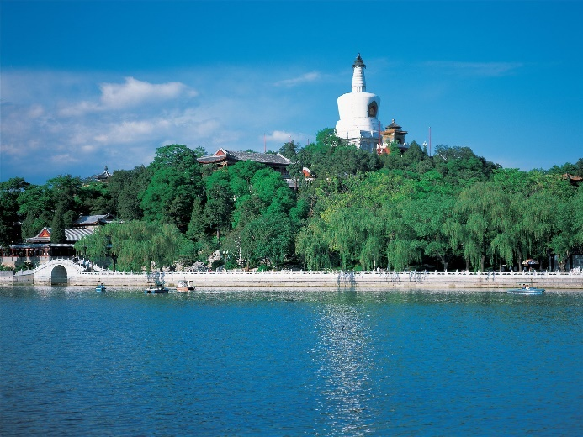
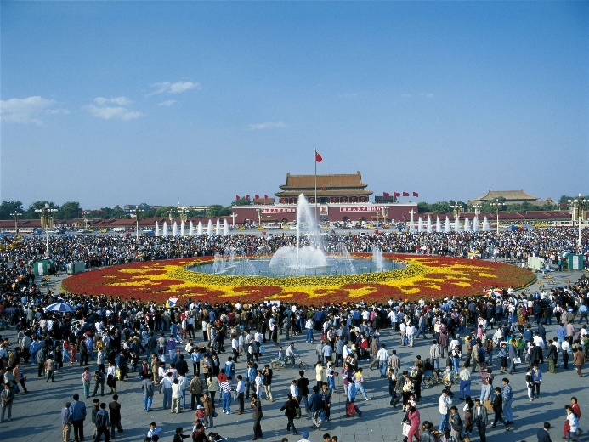
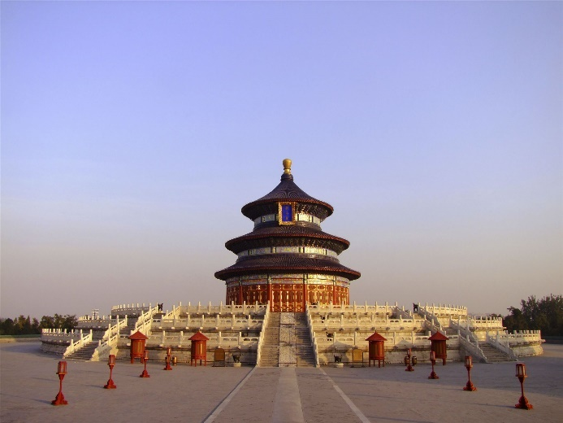

Exercise 2: Write down the proper English expressions for each picture.
北海公园
the Beihai Park
天安门广场
Tian'anmen Square
天坛
Temple of Heaven
水立方
Water Cube

Slide 22
Exercise 3: Complete the following sentences.
1. You are supposed not to_________ in the temple. (寺庙内不允许拍照。)
2. Here we are able to _____the Kunming Lake. (我们在这里能看到昆明湖。)
3. Mind your _______! (请小心脚下！)
4. ________________situates at the north end of the central axis of Beijing. (奥林匹克公园位于北京城中轴线北端。)
5. It is my pleasure to be your __________ today. (今天很高兴给诸位当导游。)
take pictures
view
steps
Olympic Forest Garden
tour guide

Slide 23
2. Read a sample of introduction to a scenic spot.
The famous West Lake is like a brilliant pearl embedded in the beautiful and fertile shores of the East China Sea near the mouth of the Hangzhou Bay. The lake covers an area of 5.6 square kilometers. The view of the West Lake is simply enchanting, which offers many attractions for tourists at home and abroad.
Tiger-clawed Spring
The legend goes that two tigers ran there and made a hole where a spring gushed out. The Longjing Tea and the Tiger-clawed Spring water are always reputed as the “Two Wonders of the West Lake”.
The Lingyin Temple
The Lingyin Temple, or the Monastery (寺院) of Soul’s Retreat, is a famous historical site of the West Lake. It is a famous ancient temple in China, in front of which are Feilai Peak, Longhong Cave and precious rock cave arts and queer and varied natural caves and gullies (溪谷) .

Slide 24
Spring Dawn at Su Causeway (堤道)
It’s a 2.8km long boulevard (要道) cutting across the south-north scenic area, and lined with trees and flowering plants. When Spring comes with crimson (深红色的) peach blossoms and green willows (柳); the scenery is all the more charming. Strolling along the boulevard, one feels as if the West Lake were wakening in dawn mist. Young willows were ethereal (优雅的), spring breeze so caressing (爱抚), and birds were chirping (吱喳叫) in unison.
Three Pools Mirroring the Moon
“There are islands in the lake and there are lakes on the islands.” The three stone towers were first built in the Song Dynasty, with the wonderful scenery of “one moon in the sky having three reflections in the lake”.

Slide 25
Exercise 4: Write a brief introduction to South Luogu Lane in Beijing according to the Chinese given below.
南锣鼓巷离紫禁城（the Forbidden City）很近，有700年的历史。与紫禁城的红墙相比，胡同和四合院的灰色具有普通百姓的气息（atmosphere）。南锣鼓巷长800米，是四合院保存（preserve）较为完好的区域之一。来此旅游你会觉得这儿就是北京的象征（symbol）。
South Luogu Lane is very close to the Forbidden City. It has a history of 700 years. Compared with the red walls of the Forbidden City, the gray walls of Hutong and Siheyuan in South Luogu Lane create an atmosphere of common people. South Luogu Lane has a length of 800 meters. It is one of the districts in which Siheyuan has been best preserved. When you travel here, it will make you feel that South Luogu Lane is the symbol of Beijing.

Slide 26
Exercise 5: Write a brief introduction to the main scenic spots in Fenghuang County. You may refer to the following information.
凤凰县的著名景点除了凤凰古城之外还有黄丝桥古城、南长城、奇梁洞。游客可以在长途汽车站乘坐公共汽车前往这些景点。节省时间的路线是先参观黄丝桥古城和南长城，之后在南长城乘坐公共汽车去凤凰古城。
Besides the Fenghuang Ancient Town, Fenghuang County is also famous for its Huangsiqiao Ancient Town (黄丝桥古城), its Ancient Great Wall in the South (南长城), and its Qiliang Cave (奇梁洞). Tourists can take a bus from the County Long-Distance Bus Station to all these scenic spots. The way to save time is to visit Huangsiqiao Ancient Town and the Ancient Great Wall in the South at first and then go to Fenghuang by bus from the Ancient Great Wall in the South.

Slide 27
Back To Contents
To The Next Section

Slide 28
Section V Career Salon: Chinese Greetings
Chinese Greetings
In different countries, people have different ways of greeting. Before your trip to China, you can get some knowledge of how Chinese people greet each other.
An introduction is the first step to establish an interpersonal relationship. A successful introduction makes the people being introduced feel closer and creates a good first impression.
Self-introduction
With regard to introducing yourself there is little difference between in China and elsewhere. It is considered polite to give your full name, job positions and the place you work for, especially on more formal occasions. Your full name with a simple greeting is enough on informal occasions.

Slide 29
Being introduced
If someone is making the introductions, to introduce yourself is considered disrespectful. So when it is your turn to be introduced, stand up, smile and look at the people also being introduced with ease. After being introduced, you can shake hands with each other and give mutual greetings, sometimes with an exchange of calling cards.
Introducing others
In China, there are many strict conventional rules on introducing others:
1.The junior should be introduced to the senior first;
2.The male should be introduced to the female first;
3.The inferior (级别较低的) should be introduced to the superior first;
4.The host should be introduced to the guest first.
These ways to introduce show high respect to the senior, the female, the superior and the guest. However, if you are in a generally more informal occasion, the introduction to others can be less ceremonious (讲究礼仪的) .

Slide 30
Back To Contents
To The Next Unit

Slide 31
Unit 2 Museum Guide
1
Section I Introduction: Museum Guide
Section II Intensive Reading: National Museum of China
2
3
Section III Extensive Reading: Nanjing Museum
4
Section IV Writing: Introduction to a Museum
5
Section V Career Salon: Western Greetings
Back

Slide 32
Section I Introduction: Museum Guide
If you are interested in art or history, you can get paid for talking about the things you love by becoming a museum guide. A museum guide should become familiar with the person or building on display (展示) and be able to relate facts about the subject, such as important events and a timeline (时间轴) of the subject’s life span or existence. Here are some tips for a museum guide:
➢ Search the internet for news stories related to your tour.
➢ Be enthusiastic (热情的) when you greet your tour group.
➢ Make eye contact.
➢ Use humor to keep people interested.

Slide 33
Back To Contents
To The Next Section

Slide 34
Section II Intensive Reading: National Museum of China
Before Reading
Exercise 1: Have you ever been to the following museums in China? Are you interested in museums?
The Palace Museum
Emperor Qinshihuang’s Mausoleum Site Museum
Beijing Capital Museum
National Museum of China

Slide 35
Exercise 2: Do you know the functions of museums?
cultural relics and artworks collection;
exhibition display;
public education;
history and art research;
cultural communication.

Slide 36
Passage
National Museum of China
The National Museum of China (NMC) is located at the east side of Tiananmen Square. It was founded in February 2003, based on the merging of two previous museums, namely the National Museum of Chinese History and the National Museum of the Chinese Revolution. Its basic functions are the collection of cultural relics and artworks displaying, exhibits, public education, history and art research, and cultural exchange.
Today NMC is the largest museum in the world with first class facilities and capabilities. With more than forty halls, we have Ancient China and The Road to Rejuvenation (复兴) exhibitions on regular display and more than a dozen categories of displays related to special exhibitions and international exchange exhibitions. Here are some of the exhibitions: Ancient Chinese Porcelain Art

Slide 37
Date: July 3, 2016 – April 19, 2017
Venue: Gallery N17
The National Museum of China boasts a rich collection of porcelain, and over 100 pieces (sets) of them are selected to be on display. The exhibits span from the Western Zhou Dynasty to the late Qing Dynasty.
The Mediterranean World from the Collections of the Musée du Louvre
Date : October 29, 2015 – February 9, 2016
Venue : Gallery N2
The Mediterranean region has seen the convergence (汇集) of diversified cultures, and its complicated and multi-faceted (多方面的) history of civilization has made an important contribution to the development of humanity and world civilization. The exhibition shows the development of civilizations in important historic periods around this region.

Slide 38
After Reading
Exercise 3: Match the following two groups of words and phrases.
1. 文明
2. 文化交流
3. 遗迹
4. 举办地点
5. 瓷器
6. 博物馆
7. 收藏品
8. 展览，陈列
9. 历史
10. 艺术
a. museum
b. display
c. collection
d. history
e. art
f. porcelain
g. venue
h. cultural exchange
i. relics
j. civilization

Slide 39
Exercise 4: Fill in the blanks to complete each sentence according to the passage.
1. Today NMC is one of the largest_______ in the world.
2. The venue of Ancient Chinese Porcelain Art Exhibition is _________.
3. The Mediterranean World from the Collections of the Musée du Louvre Exhibition starts from _______, 2015.
4. The Ancient Chinese Porcelain Art Exhibition closes on _______, 2017.
5. Gallery N2 is the _______for The Mediterranean World from the Collections of the Musée du Louvre Exhibition.
museums
Gallery N17
October 29
April 19
venue

Slide 40
Back To Contents
To The Next Section

Slide 41
Section III Extensive Reading: Nanjing Museum
Passage
Nanjing Museum
The Nanjing Museum (南京博物院) is located in Nanjing, Jiangsu Province, China. With an area of 70 000 square meters (17 acres), it is one of the largest museums in China. The museum currently has over 400 000 items in its permanent collection.
The Nanjing Museum was one of the first museums established in China. Cai Yuanpei, the first president of the council of the museum, proposed building three major halls, named “Humanity”, “Craft” and “Nature”. Because of China’s political instability in the 1930s, only the Humanity Hall was built.

Slide 42
The main building of Nanjing Museum was designed by Xu Jingzhi and Liang Sicheng in the 1930s combining Chinese and Western architectural styles. The front section is structure of traditional style and features a golden tiled roof. In the back is a Western-style flat-roof structure. Added in the 1990s to the west of the main building is an art hall which is built in the style of Chinese architecture of the first half of the 20th century.
The layout of “six halls in one museum” is designed to build a top-class “comprehensive museum” based on the antique collections of Nanjing Museum. Besides the original Historical and Art Halls, other four newly-built halls are the Special Exhibition Hall, Digital Hall, Republic of China Hall and Intangible Cultural Heritage Hall.

Slide 43
After Reading
Exercise 1: Decide whether the following statements are true (T) or false (F) according to the passage.
1. The Nanjing Museum is located in Jiangsu Province. ( )
2. The Nanjing Museum is one of the largest museums in China. ( )
3. The Nanjing Museum was the first museum established in China. ( )
4. The main building was designed by Cai Yuanpei in the 1930s. ( )
5. The main building of the Nanjing Museum was designed in a Chinese architectural style. ( )
6. The front section of the main building is structure of traditional style. ( )
7. Historical and Art halls are newly-built halls. ( )
8. The Digital Hall, Republic of China Hall and Intangible Cultural Heritage Hall are the old halls in the Nanjing Museum. ( )
T
T
F
F
F
T
F
F

Slide 44
Exercise 2: Fill in the blanks with words or phrases according to the passage.
the location of the Nanjing Museum
the area of the Nanjing Museum
the first president of the council of the museum
the designer of the main building
the number of newly-built halls in the Nanjing Museum
Nanjing, Jiangsu Province
70 000 square meters
Cai Yuanpei
Liang Sicheng and Xu Jingzhi
four

Slide 45
Back To Contents
To The Next Section

Slide 46
Section IV Writing: Introduction to a Museum
1. Finish the following exercises concerning the useful words and expressions in this unit.
Exercise 1: Fill in the blanks to complete each word.
r
u
r
e
u

Slide 47
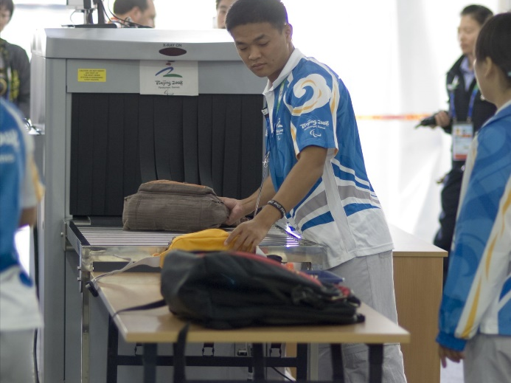
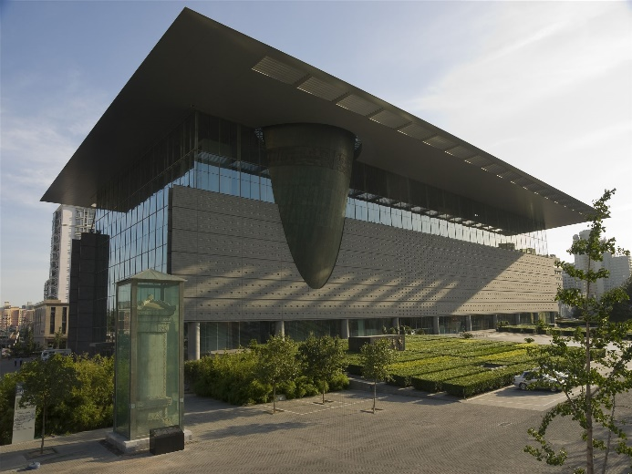
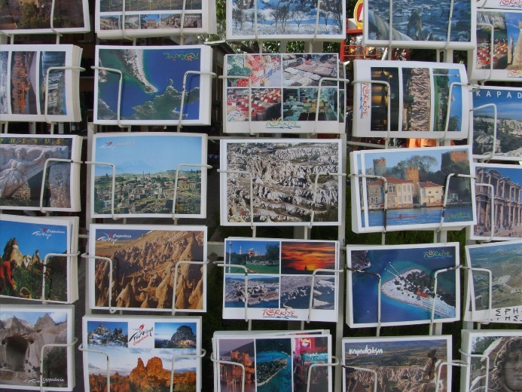

Exercise 2: Write down the proper English expressions for each picture.
安检
security check
首都博物馆
Beijing Capital Museum
明信片
postcards
危险品
dangerous articles

Slide 48
Exercise 3: Complete the following sentences.
1. Thank you for your _______. (谢谢合作。)
2. Please mute your _________. (请将手机静音。)
3. Please do not _______the objects on display. (请勿触摸展品。)
4. Beijing Capital Museum is ________to all visitors. (首都博物馆对所有游客免费开放。)
5. No _______or tripod. (不许使用闪光灯或三脚架。)
cooperation
mobile phone
touch
free
flash

Slide 49
2. Read a sample introduction to a museum.
An Introduction to the Meridian Gate in the Palace Museum
The Meridian Gate (午门) is the southern (and the largest) gate of the Forbidden City. It has five arches. The three central arches are close together; the two flanking arches are farther apart from the three central arches. The central arch was formerly reserved for the Emperor alone; the exceptions were the Empress, who could enter it once on the day of her wedding, and the top three scholars of the triennial (每三年
的) civil service examinations, who left the exams through the central arch. All other officials and servants had to use the four side arches.
Above the arches are a series of buildings. The central one is the palace of nine bays wide, with double roofs. In each side, the 13 bays-wide building, single roof, connects the two pavilions on the top. The Emperor of China reviewed his troops from this location during the Ming and Qing Dynasties.

Slide 50
Exercises 4: Suppose you are an English-speaking guide and tomorrow you are going to visit the Palace Museum with an American tourist. Read the passage above and write an interesting introduction to the Meridian Gate for the interpretation tomorrow.

Slide 51
Exercises 5: Please write a story related to a museum in China. Try to tell the story in a simple and vivid way to impress the foreign visitors to the museum. Search the Internet if necessary.

Slide 52
Back To Contents
To The Next Section

Slide 53
Section V Career Salon: Western Greetings
Western Greetings
The simplest greeting in western countries is “Good morning”, “Good afternoon’” or “Good evening”. This greeting is given to one whom you know only slightly, or to any one you are passing quickly. “How are you” is usually used when you are not in such a hurry. No answer is expected other than “Fine, thank you.” “Hello” is the most common form of greeting between good friends. But a greeting is never just that. To be both polite and friendly, you should know something more.
In most western countries, people usually shake hands when they meet. The British only say “hello” when they see friends. That’s why French people think the British are unfriendly and impolite. They kiss friends on both cheeks (面颊) each time they meet and leave. However, to Americans, kissing is very strange between two male friends.

Slide 54
A proper introduction will leave a good first impression upon others. Most people in many western countries don’t like using Mr., Mrs. or Miss in introductions. They find these terms too formal. They prefer first names to formal titles in most cases. For example, a gentleman may say, “Glad to meet you. I’m Miller. But call me Paul.” Sometimes a woman you meet for the first time may say, “Don’t call me Mrs. Smith. Just call me Sally.” So if your friends from Western countries do not use your last name or titles, don’t feel that they have been impolite. They only want to show friendliness.
Some of the ways above to greet people might be strange for you, but do remember: when in Rome, do as the Romans do.

Slide 55
Back To Contents
To The Next Unit

Slide 56
Unit 3 Travel Consultation
1
Section I Introduction: Junior Travel Consultant
2
Section II Intensive Reading: What Is a Senior Travel Consultant?
3
Section III Extensive Reading: “Click” to Get a Perfect Travel Plan
4
Section IV Writing: MEMO
5
Section V Career Salon: Chinese Gift-giving Etiquette
Back

Slide 57
Section I Introduction: Junior Travel Consultants
A junior (初级的) travel consultant (顾问) works with travel agency. Junior travel consultants help make arrangements (安排) for employees or clients to design tour plans, lending a hand in lining up flights, car rentals and hotel booking.
A junior travel consultant performs many tasks and needs a wide array of skills:
➢ being a strong communicator and highly organized;
➢ being a good record-keeper;
➢ traveling frequently to gain more personal travel experience.

Slide 58
Back To Contents
To The Next Section

Slide 59
Section II Intensive Reading: What Is a Senior Travel Consultant?
Before Reading
Exercise 1: Do you know their duties and responsibilities?
travel consultant
travel agency
tour leader
tour writer

Slide 60
Exercise 2: What is the difference between a junjor travel consultant and a senior travel consultant?

Slide 61
Passage
What Is a Senior Travel Consultant?
A senior travel consultant works with a travel agency. He/She usually starts a career as a Junior Consultant for an agency after graduating from college or having had at least 2 to 5 years of strong sales experience, and works closely with clients and industry agencies to provide business trips, vacations and itineraries.
A senior travel consultant can be an employee or an owner in the travel agency. He/She trains junior consultants, plans and manages trips as well as special projects. The consultant arranges for airline ticketing, hotel accommodations and car rentals for the clients, and works to save their money, and keeps them informed about the trip.

Slide 62
A senior travel consultant shall keep client profiles and be familiar with any special needs and requests. He/She should know a lot about the airline regulations, current affairs, and the daily price market. Many agencies will require a consultant to be familiar with the Global Distribution System.
A senior travel consultant must maintain good customer and community relations. He/She must be knowledgeable and possess good people skills. A successful senior travel consultant is often well-paid and may also be awarded bonuses and trips.
A travel agency will have its own specific requirements for a senior travel consultant. An agency may ask that the consultant be able to hear well while multitasking, particularly when on the phone. Physical requirements may also include the ability to read fine print while working with printed materials.

Slide 63
After Reading
Exercise 3: Match the following two groups of words and phrases.
1. 售票
2. 航空公司
3. 销售经验
4. 旅行社
5. 旅行日程
6. 客户
7. 顾问，咨询
8. 初级的
9. 高级的
10. 职业
a. junior
b. senior
c. career
d. consultant
e. client
f. itinerary
g. ticketing
h. airline
i. sales experience
j. travel agency

Slide 64
Exercise 4: Fill in the blanks to complete each sentence according to the passage.
1. The senior consultant will start a career as a ___________.
2. The consultant works to _______clients’ money.
3. A senior travel consultant must maintain good customer and community _______.
4. A successful senior travel consultant is often _______.
5. A _________will have its own specific requirements for a senior travel consultant.
junior consultant
save
relations
well-paid
travel agency

Slide 65
Back To Contents
To The Next Section

Slide 66
Section III Extensive Reading: “Click” to Get a Perfect Travel Plan
Passage
“Click” to Get a Perfect Travel Plan
A travel consultant can help you plan a trip easily.
Booking a tour at the travel agency is often customer friendly without forced commitment. You only book exactly what you want, clearly knowing what you get before you go.
Submitting your tour inquiry is NOT an act of reserving a tour, but rather a way of establishing communication with a local travel expert who will be helping with your tour. Tour booking will be confirmed with payment only when you are totally satisfied with your personalized tour plan.

Slide 67
You can start it by browsing sample tours categorized by travel interests and themes. When a sample tour interests you, simply click on the “Free Inquiry” botton to state your personal preferences and how you want your tour to be customized.
If you need advice to make up your mind, or you already have a plan in mind, or you do not find a sample tour perfectly matched to fit your interests, you can just let us tailor a tour with exactly what you want. You need to fill out a custom tour plan form. Our tailor-made service is FREE and NOT a commitment for booking.
Your tour inquiry will be replied to within 24 hours, from one of our travel consultants. He/She will propose a tour plan according to your tour inquiry. You can further discuss all the details of the tour plan until you are totally satisfied with it.

Slide 68
After Reading
Exercise 1: Decide whether the following statements are true (T) or false (F) according to the passage.
1. A travel consultant can help you plan a trip easily. ( )
2. Submitting a tour inquiry is an act of reserving a tour. ( )
3. Submitting a tour inquiry is a way of establishing communication with a local travel expert. ( )
4. You can confirm your booking with payment if you are totally satisfied with your personalized tour plan. ( )
5. You can click on the “Free Inquiry” botton to state your personal preferences. ( )
6. You need not to fill out a custom tour plan form for the tailor-made service. ( )
7. The tailor-made service is a commitment for booking. ( )
8. If you do not find a sample tour perfectly matched to your interests, we can provide free tailor-made services for you. ( )
9. Our travel consultant will reply your tour inquiry within a week. ( )
10. All the details of the tour plan can be further discussed until you are totally satisfied with it. ( )
T
F
T
T
T
F
F
T
F
T

Slide 69
Exercise 2: Fill in the blanks with words or phrases according to the passage.
Who can help you plan a trip easily?
How to confirm your tour booking?
What form do you need to fill out for the tailor-made service?
How long will your tour inquiry be replied?
Who will propose a tour plan according to your tour inquiry?
a travel consultant
with payment
a custom tour plan form
within 24 hours
one of our travel consultants

Slide 70
Back To Contents
To The Next Section

Slide 71
Section IV Writing: MEMO
1. Finish the following exercises concerning the useful words and expressions in this unit.
Exercise 1: Fill in the blanks to complete each word.
r
r
r
i
q
k
u
e
s
t

Slide 72

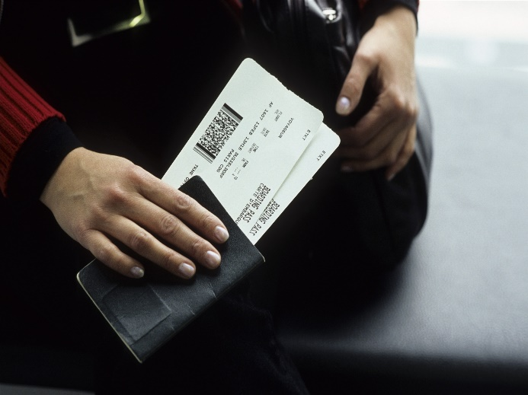
Exercise 2: Write down the proper English expressions for each picture.
tour leader
领队
airline ticket
机票

Slide 73
Exercise 3: Complete the following sentences.
1. Because of a lack of bookings, many airlines will offer __________to certain passengers. (由
于订票不足，很多航空公司为一些乘客提供免费升级。)
2. I will _______a five star hotel for you. (我将为您安排一家五星级酒店。)
3. Do you have any _________? (您有什么特殊要求吗？)
4. Please feel free to _______me if you need further information. (如需要更多信息，请您
与我联系。)
5. I highly _______your considerations to these proposals. (我非常感谢您对这些提议的考虑。)
free upgrades
arrange
special request
contact
appreciate

Slide 74
2. Read a sample memo.
A memo is generally is not as formal as a written letter. However, it is certainly not as informal as a personal letter. The tone of a memo is generally friendly as it is a communication between colleagues. Keep the memo concise and to the point. If necessary, introduce the reason for the memo with a short paragraph. Use bullet points to explain the most important steps in a process. Use a short “Thank you” to finish the memo. Here is a sample:

Slide 75
MEMO
To: Henry Smith
From: Jack Wang, Personnel Manager
Date: June 4th, 2016
Subject: Applicants for Sales Post
Attached are the resumés and certificates of four applicants who have applied for your department position.
Please evaluate these applicants and then recommend the applicants you want to interview to me. As soon as I have the names, I will make arrangements for the interviews. Thank you.

Slide 76
Exercise 4: Translate the underlined parts in the following memo.
MEMO
To: Purchasing & Sales Supervisor
From: General Manager
Re: Coffee and Tea Supply
Date: 23rd, May
I am very surprised that MasterBack is not going to deliver the coffee and the rest of
the tea until the end of the month. We have now found a new supplier, so please cancel
our order with them.

Slide 77
To: Purchasing & Sales Supervisor致：采购和销售主管
From: General Manager来自：总经理
deliver送（货）
a new supplier一家新的供货商
cancel our order取消我们的订单

Slide 78
Exercise 5: Write a memo according to the information given below.
On July 12th, Mr. Mike Johnson informs all sales representatives of the quarterly meeting. The meeting will be held on July 20th at Holiday Inn in Beijing. It will start at 10:00 a.m. and end at 5:00 p.m.
MEMO
To: All Sales Representatives
From: Mike Johnson
Date: July 12th
Subject: the Quarterly Meeting
The quarterly meeting will be held on July 20th at Holiday Inn in Beijing. It will start at 10:00 a.m. and end at 5:00 p.m.

Slide 79
Back To Contents
To The Next Section

Slide 80
Section V Career Salon: Chinese Gift-giving Etiquette
Chinese Gift-giving Etiquette
On July 12th, Mr. Mike Johnson informs all sales representatives of the quarterly meeting. The meeting will be held on July 20th at Holiday Inn in Beijing. It will start at 10:00 a.m. and end at 5:00 p.m.
Chinese people prefer to choose gifts that have practical values. In the West, it is polite to open gifts to express appreciation as soon as they are given. However, in China, the situation can be quite different. Many people give gifts without wrapping them, and if they wrap them, they usually tell the receiver what is inside. Then the receiver will thank the sender and put the gift aside without unwrapping it since they already know what is inside. Normally Chinese people feel that if you open the gift as soon as it is given, you might embarrass the person who gives the gift and you might be thought of as greedy. So, Chinese people tend to open the gifts after the visitors have left. Gifts are generally given on Chinese New Year, weddings, birthdays and Midautumn Day.

Slide 81
Here are some useful tips on Chinese gift-giving:
Do not give scissors, knives or other cutting utensils as they indicate the severing of the relationship.
Do not give clocks or straw sandals as they are associated with funerals and death.
Always present gifts with two hands.
Gifts are not opened when received.
Gifts may be refused for politeness before they are accepted.

Slide 82
Back To Contents
To The Next Unit

Slide 83
Unit 4 Travel Marketing
1
Section I Introduction: Tourism Sales and Marketing
Section II Intensive Reading: Travel Marketing
2
3
Section III Extensive Reading: Online Travel Service Booming
4
Section IV Writing: Business Email
5
Section V Career Salon: Western Gift-giving Etiquette
Back

Slide 84
Section I Introduction: Tourism Sales and Marketing
Tourism marketing requires creative individuals who are passionate (热情的) about the destination they’re selling. These people work in sales department in a travel agency or company. They create relationships with local tourism partners (hotels, attractions and venues) and with targeted visitors whom they want to attract to the destination. A person in tourism marketing could lead a large team or handle the duties alone.
A good salesperson in the travel industry shall be:
➢ Good at communicating with people;
➢ Skillful at sales techniques (技巧);
➢ Familiar with online travel services.

Slide 85
Back To Contents
To The Next Section

Slide 86
Section II Intensive Reading: Travel Marketing
Before Reading
Exercise 1: Can you name some of the popular online tour operators in China?

Slide 87
Exercise 2: What do people sell in the tourism industry?

Slide 88
Passage
Travel Marketing
Travel marketing must reach a wide range of people instead of focusing on agents. With the development of online travel service, consumers are able to plan and purchase more of their travel services without the help of a travel agent. While this is convenient for travelers, it makes selling a travel product more difficult.
Social media is one of the most powerful tools in travel marketing and promotion. Because more people use Weibo, WeChat, and other social networking sites, you can reach them when a trip is in progress.
Many regular travelers read magazines about travel, both online and in print. By marketing your travel services in these publications, you increase your chances of gaining a steady base of customers who purchase services frequently.

Slide 89
For many travelers, price is the bottom line. If your travel company can offer low prices, focus on them in your marketing materials. If you sell flights to a certain city for $100, and that is the lowest of any carrier, say so in advertisements.
If your travel company has a website, be sure to create an area for visitors to sign up for your travel deals. Once a week, send out an email that details new products and new deals, the regular exposure to your name and services will increase the chances that they turn to you when it comes time to purchase travel products.

Slide 90
After Reading
Exercise 3: Match the following two groups of words and phrases.
1. 低价
2. 报价
3. 服务
4. 广告
5. 旅游产品
6. 促销
7. 社交媒体
8. 计划
9. 购买
10. 营销
a. marketing
b. plan
c. purchase
d. promotion
e. low price
f. social media
g. travel product
h. advertisement
i. offer
j. service

Slide 91
Exercise 4: Fill in the blanks to complete each sentence according to the passage.
1. Travel marketing must reach a _______wide of people.
2. Consumers are able to plan and purchase more of their travel services without the help of a _______.
3. Social media is one of the most _______tools in a travel marketing and promotion.
4. If your travel company can _______ low prices, focus on them in your marketing materials.
5. If your travel company has a _______, be sure to create an area for visitors to sign up for your travel deals.
range
travel agent
powerful
offer
website

Slide 92
Back To Contents
To The Next Section

Slide 93
Section III Extensive Reading: Online Travel Service Booming
Passage
Online Travel Service Booming
While booking flights or hotels online is common in Western countries, but it’s not a popular way of doing things in China. But, as our reporter Zhang Ni finds out, the situation is changing.
The summer travel season has not arrived, but Zhao Yun’s team are already busy designing their travel products. Zhao Yun, Travel Products Department of Ctrip.com, said “We have made lists of hotels and restaurants in our travel packages, and put them online. People can also see the whole trip clearly and they can also compare the prices.” Ctrip. com is one of the biggest Chinese online travel agency. It represents almost half of the

Slide 94
market share of online booking in China. Even though, the online portion of travel booking in China is only 10%, while in Western countries that is over 60%. Ding Xiaoliang, Vice President of Ctrip.com said “Currently, the majority of business trip are booked through the Internet. But most of the leisure travel or individual travel are still made offline. So how to develop leisure market and individual travel market is the common issue for all the online travel agents in China.” They are working on it by offering discounts and maximum of choices. And it seemed most of the travel services are welcomed by travelers.
China’s online travel market volume has rapidly grown by 30% last year. International players are also willing to grab this opportunity: one of the world’s biggest online booking services has just launched its hotel booking brand, with Chinese version.
Both local and international online travel agencies believe that China’s travel market has great potential. With the rapid development of Internet and communication technology, the online travel services are to become the future trend for Chinese travelers.

Slide 95
After Reading
Exercise 1: Decide whether the following statements are true (T) or false (F) according to the passage.
1. Booking flights or hotels online is not common in Western countries. ( )
2. People can see the whole trip clearly and they can compare the prices with the help of online travel services. ( )
3. Ctrip.com is one of the biggest Chinese online travel agencies. ( )
4. According to the passage, Ctrip.com represents 2/3 of the market share of online booking in China. ( )
5. Currently, the majority of business trip is booked through Internet. ( )
6. Most of the leisure travel or individual travel are made online. ( )
7. How to develop business travel market is the common issue for all the online travel agencies in China. ( )
8. China’s online travel market volume has rapidly grown by 60% last year. ( )
9. Both local and international online travel agencies believe that China’s travel market has great potential. ( )
10. The online travel services are likely to become the future trend for Chinese travelers. ( )
F
T
T
F
T
F
F
F
T
T

Slide 96
Exercise 2: Fill in the blanks with words or phrases according to the passage.
one of the biggest Chinese online travel agencies
the team that are busy designing travel products of Ctrip.com
Vice President of Ctrip.com
the market share of Ctrip.com online booking in China
the online portion of travel booking in Western countries
Ctrip.com
Zhao Yun’s team
/Travel Products Department
Ding Xiaoliang
half
over 60%

Slide 97
Back To Contents
To The Next Section

Slide 98
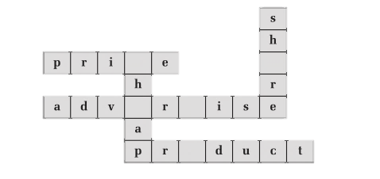
Section IV Writing: Business Email
1. Finish the following exercises concerning the useful words and expressions in this unit.
Exercise 1: Fill in the blanks to complete each word.
c
a
e
t
o

Slide 99
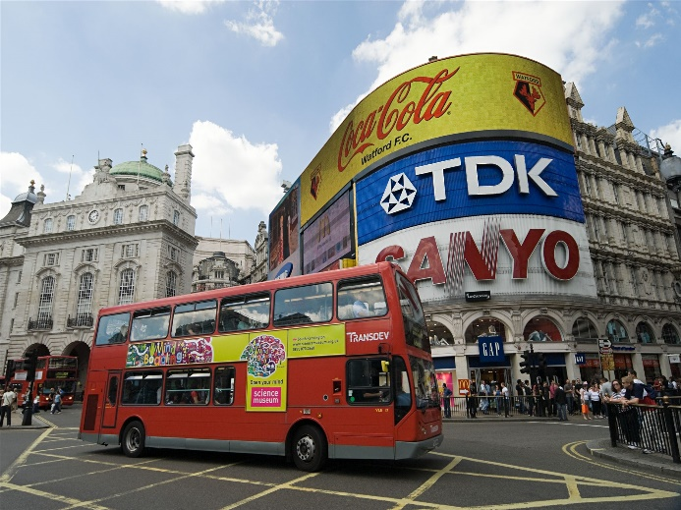
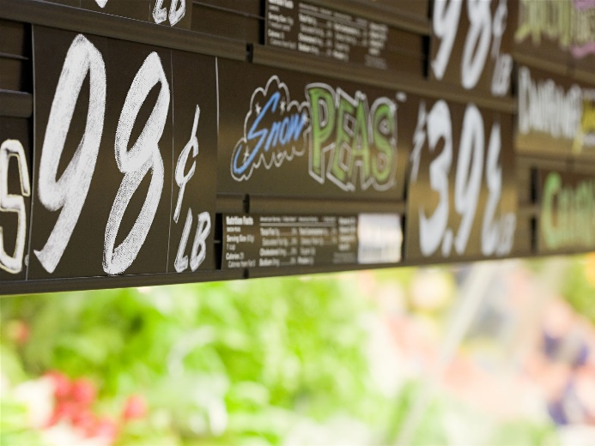


Exercise 2: Write down the proper English expressions based on the Chinese given below.
广告
advertisement
价目表
price list
网站
website
市场份额
market share

Slide 100
Exercise 3: Complete the following sentences.
1._________ is one of the useful tools in a travel marketing and promotion. (社交媒体是旅游营销及推广的有用工具之一。)
2. Would you like to _______your business trip through Internet? (您愿意通过网络预订商务旅行吗？)
3. It’s very convenient to book your trip _______. (在线预订非常方便。)
4. We can offer the lowest _______for this travel product. (我们能为这款旅游产品提供最低价。)
5. China’s travel _______has great potential. (中国旅游市场有很大潜力。)
Social media
reserve
online
price
market

Slide 101
2. Read a sample business email.
What is a good business email?
➢ Professional;
➢ Concise & clear;
➢ Meaningful;
➢ Effective & reasonable;
➢ Keep relationship.
Business email typically follows a number of steps, including the following:
➢ Subject of email;
➢ Opening and closing greetings;
➢ Beginning sentence;
➢ The main message;
➢ Ending.

Slide 102
Sample Business Email
Subject: Re: travel plan
Dear Mr. Li,
We have received your email. Please consult the travel plan with Mr. Bob Li. He
is an expert in the sales department and is familiar with the details. He will contact
you within 24 hours. Thank you for your interest.
All the best,
Thomas Huang
CITS
16 Nanjing Road
Shanghai, China
Tel: 62345336
thomashuang@cits.com

Slide 103
Exercise 4: Write an email according to the information given below.
客户Brady通过邮件询问新产品定价。假设你是阳光旅行社销售部经理Tom，请回复此邮件，告知客户旅行社刚发布的旅行产品的价格是商业秘密，不便告知，并表示歉意。 你的电话是0377-66427××。
Dear Brady,
Thanks for writing to me. I am afraid that I cannot offer you the price of our new products, which are business secrets kept in our company. I apologize for my late reply.
If you have any other questions, please contact me by phone below at any time.
Best regards,
Tom
Sales Manager
Sunshine Travel Services
Tel: 0377-66427XX

Slide 104
Exercise 5: Write an email according to the information given below.
你是阳光旅行社销售员Jim，因为没有接到咨询业务的杨先生的订单，所以写封邮件以维持客户关系，希望下次有机会可以合作。
Dear Mr. Yang，
I just wanted to drop a note to say thank you for the opportunity. I can only guess we didn’t get your order because we failed to provide you with what you wanted. If in the future I can be of service please let me know.
Thank you,
Jim
Sales Dep.
Sunshine Travel Services

Slide 105
Back To Contents
To The Next Section

Slide 106
Section V Career Salon: Western Gift-giving Etiquette
Western Gift-giving Etiquette
In America, lavish (浪费的), extravagant (奢侈的) gifts are definitely out. An appropriate alternate to a gift is to take someone to dinner, or to an entertainment event. However, gift-giving is an institution and a revered custom in Japan. According to Business Tokyo magazine, among the Japanese, “gift-giving is a necessity, not merely a nicety as in the West.” In Japan a proper gift is thought to express the giver’s true friendship, gratitude, and respect far better than words can. So if you plan to visit Japan or to have a Japanese person visit you, be prepared.
Australia is known for its friendly informality and lack of pretentiousness. So some modest gifts, such as a business diary, a paperweight, or a coffee mug might be presented as a memento of a business visit. At a trade show, T-shirts, ties, baseball caps, or a pin may be appropriate mementos.

Slide 107
The most common form of showing appreciation in Greece is probably an evening’s entertainment. If you do want to present a gift, avoid personal items, such as ties and shirts. If you are invited to a Greek home, flowers or a cake for the hostess are considered appropriate gifts.
When visiting a German home, gifts that reflect your home country are popular, and you might want to bring small gifts for the children of the family you are visiting. Gifts are usually wrapped well and many Germans spend considerable amount of time designing elegant wrappings. Most shops offer gift-wrapping services, too.
In Italy, when you are invited to someone’s home for dinner, it might be nice to bring flowers or a box of chocolates for your hostess, although it is just as considerate to have the flowers sent the next day. Yellow roses can signify “jealousy”. And in Italy never send chrysanthemums (菊花), since they suggest death.

Slide 108
Back To Contents
To The Next Unit

Slide 109
Unit 5 Travel Documents
1
Section I Introduction: Travel Documents Processing
Section II Intensive Reading: How to Apply for a Chinese Visa
2
3
Section III Extensive Reading: Passport and Visa
4
Section IV Writing: Visa Application Form
5
Section V Career Salon: Tibetan Customs
Back

Slide 110
Section I Introduction: Travel Documents Processing
Travel agencies offer travel assistance for air, land and sea travel, tour packages and travel documents processing (处理). They can also provide instructions, information and application(申请) forms for all travel needs. They guide clients in securing necessary paperwork for travel planning, visa processing and passport assistance. After verifying (核查) submitted documents, they monitor (监测) the application progress with consulates (领事馆) and embassies (大使馆).
If you are working with travel documents in a travel agency, you need to be:
➢ Good at English speaking;
➢ Skillful in filling in application forms online;
➢ Familiar with working procedures;
➢ Keeping private information secret.

Slide 111
Back To Contents
To The Next Section

Slide 112
Section II Intensive Reading: How to Apply for a Chinese Visa
Before Reading
Exercise 1: Do you know the following travel documents?
passport
visa
electronic visa
electronic ticket
entry and exit stamps
photo ID

Slide 113
Exercise 2: Can you list some steps about how to apply for a visa?

Slide 114
Passage
How to Apply for a Chinese Visa
Part A. All applicants are required to submit the following documents:
1. A valid passport and photocopy of the passport. There must be spare blank visa pages in the passport. Pages for endorsements or amendments cannot be used as a visa page. The passport should be valid for at least 6 months.
2. One completed Chinese visa application form signed by the applicant.
3. One recent passport photograph affixed to the visa application form. Social photos, copied photos and digital photos printed on ordinary paper are not acceptable.
Part B. Additional documents for different purposes:
L visa (for tourism or visiting relatives)

Slide 115
I—If for tourism:
(1) Documents mentioned in Part A;
(2) A copy of your hotel reservation in China;
(3) A copy of outward and return flight tickets.
II—If for visiting relatives in China:
(1) Documents mentioned in Part A;
(2) Proof of kinship (e.g. an invitation letter from the relative in China), but the applicants who are below 14 years old or born in China as shown in the passport are not required to submit this proof;
(3) A copy of outward and return flight ticket booking.
Visa processing time:
Normally, visas will take 4 working days to be processed. Applicants can also request express service by paying an extra fee.
Express service means that the visa can be picked up on the 2nd and 3rd working day after the application has been submitted.

Slide 116
After Reading
Exercise 3: Match the following two groups of words and phrases.
1. 证明
2. 文件材料
3. 申请人
4. 护照
5. 签证
6. 复印件
7. 有效的
8. 处理
9. 提交
10. 签发
a. applicant
b. submit
c. document
d. passport
e. photocopy
f. visa
g. valid
h. issue
i. process
j. proof

Slide 117
Exercise 4: Fill in the blanks to complete each sentence according to the passage.
1. There must be spare _______visa pages in the passport.
2. The passport should be _______for at least 6 months.
3. The applicants who are below 14 years old or born in China are not required to _______this proof.
4. Applicants can also request express service by paying extra _______.
blank
valid
submit
fee

Slide 118
Back To Contents
To The Next Section

Slide 119
Section III Extensive Reading: Passport and Visa
Passage
Passport and Visa
The passport is an official document issued by a competent public authority to nationals or to alien residents of the issuing country. Other than allowing access to another country, the passport can be used as a means of identification. Another purpose of the passport is to provide evidence of legal entry into another country.
There are several types of passports: normal passports; aliens passports that are issued to individuals living in a country of which they are not citizens; diplomatic or consular passports that are issued to diplomatic, consular and other government officials on missions; joint passports (family passports) that are issued to husband and wife with/without child/children, or holders of the passports and child/children under a certain age, or two or more children.

Slide 120
A visa is an entry in a passport or other travel documents made by a (consular) official of a government to indicate that the bearer has been granted authority to enter or re-enter the country concerned. It usually specifies the authorized length of stay, the period of validity and the number of entries allowed during that period.
Here are some types of visas:
1. Visitor visa also referred to as: entry permit, entry visa, business visa or travel pass. It provides right of entry into another country.
2. Transit visa provides right of entry into another country only for the purpose of making travel connections onward to a third country. Many countries have made agreements that allow other nationals to transit their country without the need to obtain a visa, which is transit without visa (TWOV) .

Slide 121
3. Created in 1995, the Schengen is an agreement among several member states of the European Union (EU), and effectively creates a “borderless” region known as the Schengen Area.
Under normal circumstances, once a visa has been issued, then entry into the country should be granted. Travel agents should be aware, however, that the final decision regarding entry into any country remains with the immigration officials at the entry point.
The responsibility of travel agents is to supply up-to-date and accurate information, therefore the quality of this service is extremely important, as the traveler will act on it to obtain the correct travel visas.

Slide 122
After Reading
Exercise 1: Decide whether the following statements are true (T) or false (F) according to the passage.
1. The passport cannot be used as a means of identification. ( )
2. The only purpose of the passport is to provide evidence of legal entry into another country. ( )
3. Diplomatic passports are issued to diplomatic, consular and other government officials on missions. ( )
4. Visitor visa provides right of entry into another country. ( )
5. A visa does not specify the authorized length of stay. ( )
6. A visa is showing that the bearer has been granted authority to enter or re-enter the country concerned. ( )
7. Transit without visa（TWOV）allows foreign people to transit the country without the need to obtain a visa. ( )
8. There are no immigration controls for travel within the Schengen Area. ( )
9. The final decision regarding entry into any country remains with the travel agents. ( )
10. The final decision regarding entry into any country remains with the immigration officials at the entry point. ( )
F
F
T
T
F
T
T
T
F
T

Slide 123
Exercise 2: Fill in the blanks with words or phrases according to the passage.
passports that are issued to individuals living in a country of which they are not citizens
passports that are issued to husband and wife
visa that provides right of entry into another country
visa that allows other nationals to transit their country without the need to obtain a visa
visa that creates a “borderless” region among several member states of the European Union(EU)
aliens passports
Joint passports
(family passports)
Visitor visa / entry permit
entry visa / business visa
transit without visa (TWOV)
Schengen visa

Slide 124
Back To Contents
To The Next Section

Slide 125
Section IV Writing: Visa Application Form
1. Finish the following exercises concerning the useful words and expressions in this unit.
Exercise 1: Fill in the blanks to complete each word.
h
s
n
t
r

Slide 126
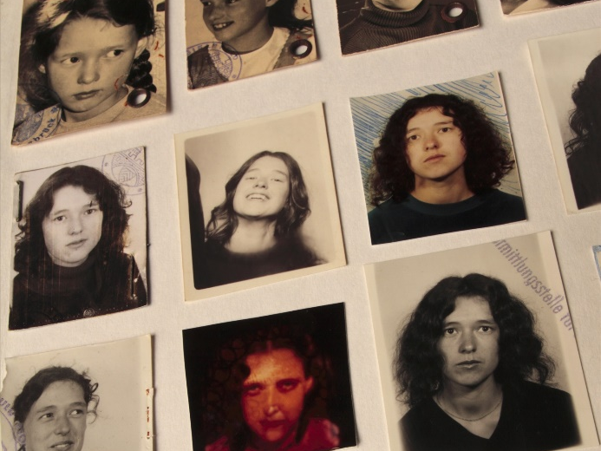
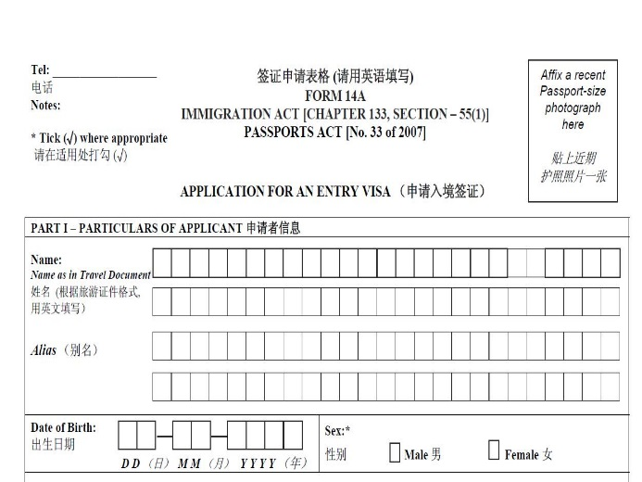


Exercise 2: Write down the proper English expressions based on the Chinese given below.
护照照片passport photo
申请表
application form
印章
stamp
签名
signature

Slide 127
Exercise 3: Complete the following sentences.
1. What is the major ________(目的) of your visit?
2. Are you applying for ________(加急的) service?
3. Have you ever been granted a Chinese ________(签证)?
4. The _______ (失效日) of the passport is Jan 12th, 2018.
5. The ________ (申请人) ’s full name is John Smith.
purpose
express
touch visa
expiry date
applicant

Slide 128
2. Read a sample of visa application form.
Visa Application Form of the People’s Republic of China

Slide 131
Exercise 4: Read the information in the form above and circle the words or phrases that you are not familiar with.

Slide 132
Exercise 5: Fill in the visa application form for a foreign client according to the following information.
John Peterson，男性，美国籍，1976年12月24日出生于纽约。社会保险号（social security number）为050-134-366。研究生，Pacific公司人力资源部经理，居住地为纽约市 Broadway 101号，邮编NY10003。电子邮件地址：johnpeterson@pacific.com，联系电话是3667082。
John持有普通护照，护照号码为USA3230099，签发地点为纽约，护照签发日期为2012年12月1日，有效期为2012年12月1日至2022年11月30日。已婚。有2个正在念书的女儿，名字分别是Lucy Peterson 和Lily Peterson。妻子Catherine Peterson是全职主妇。其妻女均为美国籍。John Peterson的紧急联系人为他的母亲Mary Peterson，电话是3667523。2016年9月1日在美国申请中国签证。

Slide 133
Back To Contents
To The Next Section

Slide 134
Section V Career Salon: Tibetan Customs
Tibetan Customs
Presenting Hada
Presenting hada is a common practice among Tibetan people to express their best wishes on many occasions, such as wedding ceremonies, festivals, visiting the elders, and entertaining guests. The white hada, a long narrow scarf made of silk, embodies purity and good fortune.
Proposing a Toast and Tea
When you come to a Tibetan family, the host will propose a toast, usually barley wine. You should sip three times and then drink up. To entertain guests with tea is a daily etiquette. The guest does not have to drink until the host presents the tea to you.

Slide 135
Back To Contents
To The Next Unit

Slide 136
Unit 6 Hotel Concierge
1
Section I Introduction: Hotel Concierge
Section II Intensive Reading: Introduction to Hotel Concierge
2
3
Section III Extensive Reading: Concierge Services in Kempinski Hotel
4
Section IV Writing: Invitation Cards
5
Section V Career Salon: Etiquette Tips for Staying in Hotels
Back

Slide 137
Section I Introduction: Hotel Concierge
The concierge (礼宾) is one of the first hotel staff to meet and greet the guests upon their arrival and show the excellent service to the guests. The concierge usually belongs to the Front Office team. The concierge works together with many colleagues (同事), especially with the receptionist (前台) and the porter (行李员). This task requires the concierge to be familiar with the routine of concierge service including greeting guests, providing luggage service for the guests, showing guests into room, answering the guests’ questions regarding the city, hotel events, tour attractions, shopping and dining.
A good concierge shall
➢ Provide services with smile and patience;
➢ Pay attention to details;
➢ Be familiar with the local places.

Slide 138
Back To Contents
To The Next Section

Slide 139
Section II Intensive Reading: Introduction to Hotel Concierge
Before Reading
Exercise 1: Do you know the following positions in hotel?
hotel representative
doorman
bellman
concierge

Slide 140
Exercise 2: What do these people do? Match the people with their duties.
1. hotel representative
2. doorman
3. bellman
4. concierge
a. providing information for guests
b. carrying luggage for guests
c. receiving guests at the airport
d. welcoming guests outside the hotel entrance

Slide 141
Passage
Introduction to Hotel Concierge
The hotel concierge position plays a vital role in the daily customer service operations of hotels and resorts. The word concierge is French in origin and means the “keeper of keys”. The concierge is the contact for hotel guests who seek information or assistance during their stay.
Although most upscale hotels use reservation agents to book most of their rooms, a hotel concierge will help reserve special suites for frequent and returning guests. These guests are often treated with a higher degree of customer service than average guests.
One of the primary duties of a hotel concierge is to inform hotel guests about events specific to the hotel. For instance, if a wine-tasting event is taking place, a concierge will let the guests know and will direct them to the correct location. A concierge may also inform certain guests of private events not open to regular guests. A concierge is the go-to person for information about the city’s scenic spots, best restaurants, shopping malls and nightclubs.

Slide 142
Many business people usually stay in hotels, so a concierge must offer up-to-date travel information. These services inform business travelers about the best flight to a specific city in order for him to arrive ahead of schedule. A concierge also calls airports and train and ship lines to ensure complete and proper reservations.
When a guest loses his wallet or needs special dry-cleaning services, a concierge handles these needs and emergencies. He also assists when a guest cannot get the special hotel room he requested. Another duty that can be arranged is to find baby-sitters if parents need to leave their children at the hotel.

Slide 143
After Reading
Section 1: Match the following two groups of words and phrases.
1. 最新的
2. 接待，礼宾
3. 确保
4. 经常的
5. 通知
6. 紧急情况
7. 帮助
8. 处理
9. 提供
10. 引导
a. concierge
b. frequent
c. inform
d. direct
e. offer
f. assist
g. handle
h. emergency
i. up-to-date
j. ensure

Slide 144
Exercise 2: Fill in the blanks to complete each sentence according to thepassage.
1. The word_______ originally means the “keeper of keys”.
2. Frequent and returning guests are often treated with a _________ of customer service than average guests.
3. If a wine-tasting event is taking place, a concierge will let the guest know and _______ him/her to the correct location.
4. When a guest loses his wallet or needs special dry-cleaning services, a concierge _______ these needs and emergencies.
5. Another duty of a concierge is to find _______ if parents need to leave their children at the hotel.
concierge
higher degree
direct
handles
baby-sitters

Slide 145
Back To Contents
To The Next Section

Slide 146
S ection III Extensive Reading: Concierge Services in Kempinski Hotel
Passage
Concierge Services in Kempinski Hotel
Concierge services are extremely important for Kempinski, as it is the concierge who responds to the guests’ needs and provides any requested services at any time. While other hotel groups have downgraded this kind of services, Kempinski’s concierge team remains highly valued not only to meet but also to exceed the expectations of our guests.
A series of programs have been developed in honor of the concierge:
Business Concierge. Kempinski’s revolutionary Corporate Account Recognition Program offers clients special discounts and privileges. To enhance and support Business Concierge, Kempinski developed a dedicated central database called KARIS (Key Accounts Rates & Information System). KARIS is unique to Kempinski and enables all sales staff to instantly access rates.

Slide 147
Leisure Concierge is available throughout the year. Leisure Concierge is a collection of promotions designed to meet the needs of leisure travelers. Packages are available in all room categories, from standard rooms to suites and include a local guide brochure compiled by the hotel concierge.
Private Concierge is Kempinski’s first guest recognition program, offering invited members enhanced personal recognition and a series of benefits.
Meeting Concierge was launched in May 2001 and promises to respond to all inquiries within 24 hours. The new program provides flexible and comprehensive services for groups of 10 participants or more as well as tailor-made services.

Slide 148
After Reading
Exercise 1: Decide whether the following statements are true (T) or false (F) according to the passage.
1. Some of the hotel groups have downgraded the concierge services. ( )
2. The concierge teams are not highly valued in Kempinski. ( )
3. Kempinski’s concierge team can only meet the expectations of our guests. ( )
4. KARIS was developed to enhance and support Business Concierge in Kempinski. ( )
5. KARIS is open to all sales staff working in the hotel. ( )
6. Leisure Concierge is designed to meet the needs of leisure travelers. ( )
7. Leisure Concierge offers a local guide brochure compiled by the hotel concierge. ( )
8. Private Concierge offers invited members enhanced personal recognition and a series of benefits. ( )
9. Meeting Concierge was launched in May 2010. ( )
10. Meeting Concierge promises to respond to all inquiries within 12 hours. ( )
T
F
F
T
T
T
T
T
F
F

Slide 149
Exercise 2: Fill in the blanks with words or phrases according to the passage.
Types of Concierge in Kempinski Hotel | Services Offered
Business Concierge | Its revolutionary corporate account recognition program offers clients special __________________________________.
Leisure Concierge | Packages are available in all room categories and include a compiled by the hotel Concierge ________________________.
Private Concierge | Offers ______________________enhanced personal recognition and a series of benefits.
Meeting Concierge | Promises to to __________all inquiries within 24 hours. Provides flexible and comprehensive services for groups of __________participants or more as well as tailor-made services.
discounts and privileges
local guide brochure
invented members
respond
10

Slide 150
Back To Contents
To The Next Section

Slide 151
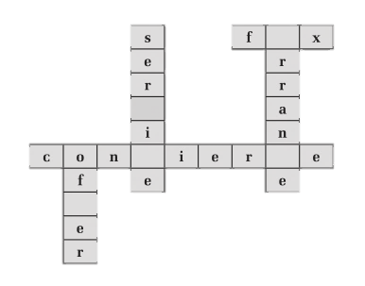
Section IV Writing: Invitation Cards
1. Finish the following exercises concerning the useful words and expressions in this unit.
Exercise 1: Fill in the blanks to complete each word.
a
v
c
g
f

Slide 152
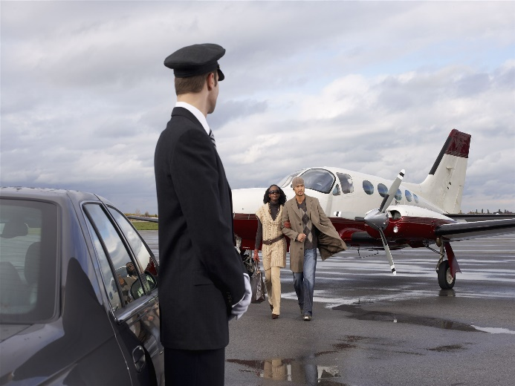

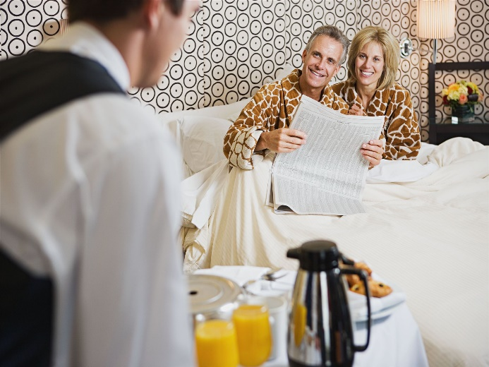

Exercise 2: Write down the proper English expressions based on the Chinese given below.
接机（接站）服务pick-up service
洗衣服务
laundry delivery service
房间内就餐服务
room dining service
秘书服务
secretarial services

Slide 153
Exercise 3: Complete the following sentences.
1. The hotel offers _______(叫醒) service if required.
2. We will offer the _______ (专属定制) services for the guests based on guest’s preference.
3. Scheduling the _______ (行程表) for guest is also included in our services.
4. Would you like me to call a _______（出租车) for you?
5. How many pieces of _______ (行李) do you have?
wake-up
tailor-made
itinerary
taxi
luggage

Slide 154
2. Read an invitation Cards.
A formal invitation includes the following information: the name of the person who sends it, the occasion or matter concerned and the name of the person to whom the invitation is sent. Usually both the receiver and sender should be written in third person — note that in some occasions, “you” is used instead.
R.S.V.P., an abbreviation for the four French words which means Please Reply are written in the lower right or left-hand corner of the invitation, and the telephone number, at which the person invited is asked to call to give a reply. The words Regrets Only mean that a telephone call is expected only when the person invited cannot make it.

Slide 155
Invitation Card
On the occasion of the nineteenth anniversary of the founding of the Sunshine Hotel in China, the general manager Mr. Johnson requests the honor of your presence at a reception to be held at the hotel on Sunday, the 9th Sept., 2017, from 19:00–20:00.
No Dress
Regrets Only: 6443225

Slide 156
Exercise 4: Write an invitation card according to the following information.
JOY酒店销售部经理Carl Peterson想邀请客户Brown夫妇参加2017年12月24日晚7点在酒店餐厅举办的圣诞晚宴。没有着装要求，收到请回复。电话：136112345××。
Invitation Card
Mr. Carl Peterson
Director of the Sales Department in JOY Hotel requests the honor of Mr. and Mrs. Brown at a Christmas dinner party on Dec 24th, 2017 at seven o’clock p.m. at the hotel restaurant.
No Dress Code
R.S.V.P. 136112345XX

Slide 157
Exercise 5: Write a greeting card with the following information.
JOY酒店向在酒店举行婚礼的客人Smith夫妇赠送一个小花篮，请写一张祝福的卡片附上。
Greeting Card
We request Mr. and Mrs. Smith’s kind acceptance of this small present of flowers in a basket. Best regards to your wedding!
JOY Hotel

Slide 158
Back To Contents
To The Next Section

Slide 159
Section V Career Salon: Etiquette Tips for Staying in Hotels
Etiquette Tips for Staying in Hotels
In much the same way that you probably have house rules in your own home, there is a list of acceptable and unacceptable things you can do when staying in a hotel. Understanding and following these general etiquette tips will ensure you have an enjoyable, and trouble-free break from your home environment.
Just because you are paying to stay at the hotel, it does not mean you have to make demands. Unless your room is dirty, untidy or unsuitable for your needs being a gracious guest means you can enjoy your break without getting stressed. If you ask for room service or additional pillows, etc., do allow staff sufficient time to fulfill your request before making further demands.
If staying in a hotel for business purposes, it is not recommended that you use your room for business meetings — many hotels will have conference or business facilities that provide a far more suitable option.

Slide 160
If you want to enjoy the pleasure of having breakfast in bed, make sure you put in your breakfast request the evening before. Most hotels will provide you with a breakfast order card, which you fill in and hang on the outside of your hotel room door. When your breakfast arrives, it is acceptable to greet the waiter in your robe, and to allow him/her to set up the meal for you.
It is customary to tip the porter who delivers your luggage to your hotel room. It is also courteous to tip other members of staff who tend to your requests. However, a verbal thank-you can also sometimes be sufficient. It is important to make sure you offer a tip to a staff member who has run more than one errand for you, or who has been especially helpful.

Slide 161
Back To Contents
To The Next Unit

Slide 162
Unit 7 Hotel Reception
1
Section I Introduction: Hotel Receptionist
2
Section II Intensive Reading: Procedures of Making a Room Reservation
3
Section III Extensive Reading: Front Desk Hospitality Training Can
Generate Future Business
4
Section IV Writing: Reservation Form
5
Section V Career Salon: Chinese Dining Etiquette
Back

Slide 163
Section I Introduction: Hotel Receptionist
A hotel receptionist (前台) acts as the main point of contact with guests for a hotel, sorting (整理) room bookings, welcoming guests and checking them in, as well as handling their queries during their stay. Responsibilities (责任) can also cover organizing bills and processing payments (付款), passing messages onto guests, dealing with complaints (投诉), and handling foreign currency in an exchange service. Hotel receptionists usually work in shifts that include nights, weekends and public holidays. Once recruited by a hotel, a receptionist will be trained by experienced fellow staff.
A qualified hotel receptionist needs to be:
➢ Good at English listening and speaking;
➢ Skillful in computer operation;
➢ Good at communication skills;
➢ Familiar with working procedures (程序);
➢ Patient and discreet (谨慎的).

Slide 164
Back To Contents
To The Next Section

Slide 165
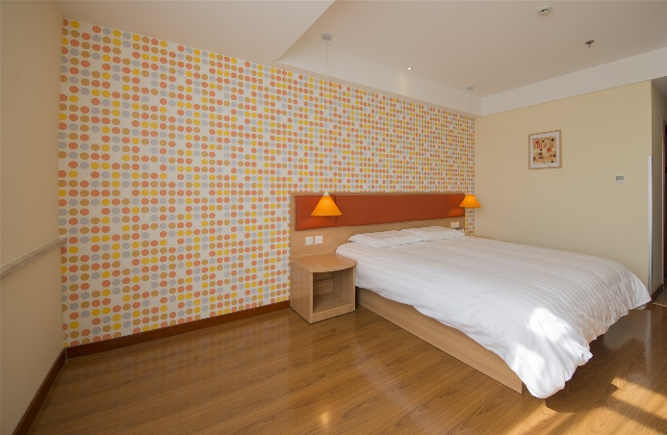
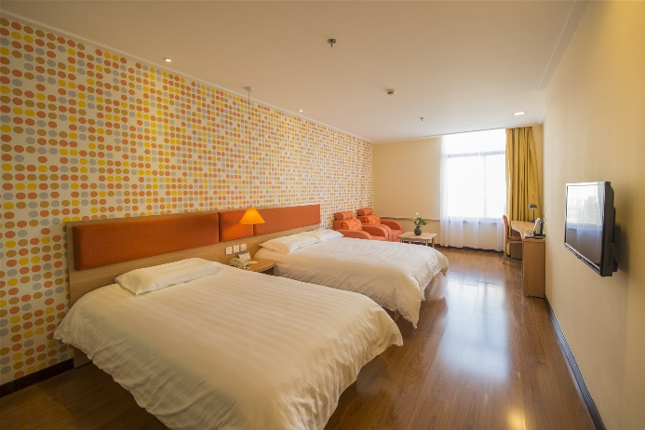
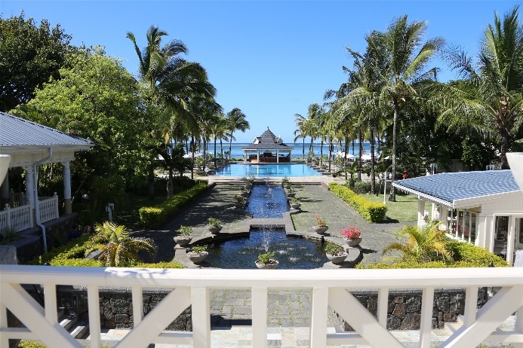
Section II Intensive Reading: Procedures of Making a Room Reservation
Before Reading
Exercise 1: Look at the pictures below and write the proper English expressions of hotel rooms.
single room
double room
ocean view room

Slide 166
Exercise 2: How many types of hotel rooms do you know?

Slide 167
Passage
Procedures of Making a Room Reservation
The reservations department is the first contact that a guest has with a hotel. Staff in the reservations department determines the guest’s first impression of the hotel. It’s their duty to be skillful in following reservation procedures, which can be done by telephone, at the front desk or through a computerized online system.
➢ Answer the call within three rings (for telephone request) and ask the guest courteously how you can assist him/her.
➢ Write down the guest’s name (first name & last name) correctly, the guest’s name should be used properly during the following conversation.
➢ Ask the guest for the arrival date and time.
➢ Ask the guest for how many nights he/she wants to make a booking.
➢ Ask for the number of people and the number of rooms (if booking for more than 1 person).
➢ Check room availability and rates quickly and explain the different available rooms to the guest. Ask what type of room the guest prefers.

Slide 168
◆ Single room;
◆ Double room;
◆ Connecting room;
◆ Business suite;
◆ Deluxe suite;
◆ Presidential suite.
➢ Ask for the guest’s preferences:
◆ King size bed or twin beds;
◆ Smoking or non-smoking room;
◆ Ocean view;
◆ High floor.
➢ Ask if the guest has any other special requests/preferences. Introduce the hotel and room facilities to the guest if asked.

Slide 169
➢ Ask for the personal details of the guest:
◆ Passport or ID number;
◆ Address;
◆ Contact telephone number;
◆ Native language.
➢ Explain our guarantee policy and ask if the guest wants to guarantee the booking. If yes: ask for their credit card number and its expiration date. Inform the guest that the reservation will generally be kept available till 6:00 p.m. of the check-in date.
➢ Confirm the booking to the guest:
◆ Repeat the guest’s name, date of arrival, number of nights, number of people (and number of rooms if more than 1);
◆ Confirm the room type, bed type and other special requests;
◆ Confirm the room rate (per room per night).
➢ Ask if the guest wants to receive a confirmation letter. If yes: ask for their email address or fax number. If possible, give the confirmation number of this booking.
➢ Ask if the guest has any other questions or requests.
➢ Thank the caller for calling and wish the guest a pleasant day.

Slide 170
After Reading
Section 1: Match the following two groups of words and phrases.
1. 单人间
2. 豪华套房
3. 偏好
4. 到达日期
5. 确认
6. 房间价格
7. 信用卡
8. 重复
9. 预定
10. 前台
a. reservation
b. the front desk
c. single room
d. deluxe suite
e. preference
f. date of arrival
g. confirm
h. room rate
i. credit card
j. repeat

Slide 171
Exercise 2: Fill in the blanks to complete each sentence according to the passage.
1. She is skillful in the room reservation _______.
2. He wants to _______a booking for three nights.
3. What type of room does the guest _______?
4. The reservation will generally be kept available till 18:00 of the _______date.
5. This guest wants _______to a confirmation letter.
procedure
make
prefer
check-in
receive

Slide 172
Back To Contents
To The Next Section

Slide 173
Section III Extensive Reading: Front Desk Hospitality Training Can Generate Future Business
Passage
Front Desk Hospitality Training Can Generate Future Business
1. When it comes to creating positive first impressions, the job of front desk associate is one of the most important. For guests booking online or via third parties, the front desk is their first impression. Even for those who have spoken with the reservations team by phone before arrival, their front desk arrival experience will set the tone for their entire stay.
2. Guests who have a positive experience at check-in are more understanding later, if/when they have objections or complaints later during their stay. In other words if they have a good experience at the front desk, they will be much more forgiving later, when a room service tray is delivered late, when the air conditioning breaks, or when a housekeeping request is overlooked. In contrast, guests who have a negative first impression can become hyper-critical; they will spend the rest of their stay almost looking for things to add to their “list,” which they will giving to their attorney first thing on Monday.

Slide 174
3. Years ago we were always told that an unhappy guest tells 9–10 other people. Now in the era of consumer generated media and social networking, the potential reach of “word of mouth advertising” is much greater. The potential negative (or positive) impact of a guest review on the Internet is almost unimaginable compared to days of old when we only had to worry about someone telling their friends and neighbors.
4. Unfortunately, just as it always has, most training that takes place these days at the front desk is still of the “on-the-job” variety with little or no direct involvement from upper and mid- level management. Instead, the new front desk staff spend their first day shadowing whichever veteran staff member happens to be working that day; someone who likely has no training skills and few if any training resources. Do you remember the game of “Telephone” or “Whisper down the lane” we all played as kids whereby the first person would be told a story and then would have to pass it on to the next player, who would pass it to the next, etc…? Do you remember how much the story changes after having been passed to just three or four people? Using this analogy,
it is easy to imagine how important procedures, standards, and processes don’t get properly communicated to the new staff and thus eventually erode over time.
5. Hotel managers in today’s era need to recognize how important it is to properly train new staff, especially those at the front desk, and to have a formalized process in place for both new- hire and ongoing training.

Slide 175
After Reading
Exercise 1: Decide whether the following statements are true (T) or false (F) according to the passage.
1. The front desk is the guest’s first impression on the hotel. ( )
2. For guests booking online, the front desk is not their first impression. ( )
3. If the guests have a good experience at the front desk, they will be much more forgiving later. ( )
4. Guests who have a negative first impression can become less-critical. ( )
5. The impact of a guest review on the Internet is useless to the hotel. ( )
6. We only had to worry about someone telling their friends and neighbors in the old days. ( )
7. Most training these days at the front desk is with much involvement from upper and mid-level management. ( )
8. All the staff members at the front desk have no training skills. ( )
9. It is important to train new staff properly, especially those at the front desk. ( )
10. The important procedures, standards, and processes don’t get properly communicated to the new staff. ( )
T
F
F
T
T
T
T
T
F
F

Slide 176
Exercise 2: Fill in the blanks with words or phrases according to the passage.
Main Idea | Paragraph No.
Improper training for the new staff.
Proper training needed.
Impact of guest’s review.
Good first impression vs. bad first impression.
Front desk and the guest’s first impression.
4
5
3
2
1

Slide 177
Back To Contents
To The Next Section

Slide 178
Section IV Writing: Reservation Form
In order to make sure a smooth hotel check-in, guests usually reserve rooms in advance, which is generally done through telephone or Internet. With regard to the hotel staff, he/she should know how to fill out the reservation form correctly, rapidly and clearly according to the information from the guest.
A reservation form should consist of:
Personal information including the guest’s name, company, nationality, city, address, fax, email, etc.
Guests’ requirements including time for check-in and check-out, type of rooms, payment, special request, etc.

Slide 179
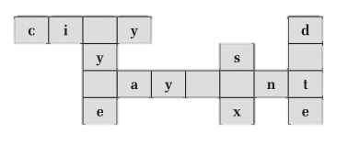
1. Finish the following exercises concerning the useful words and expressions in this unit.
Exercise 1: Fill in the blanks to complete each word.
t
a
p
m
e

Slide 180
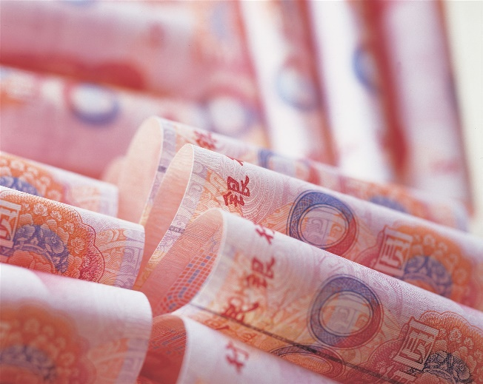
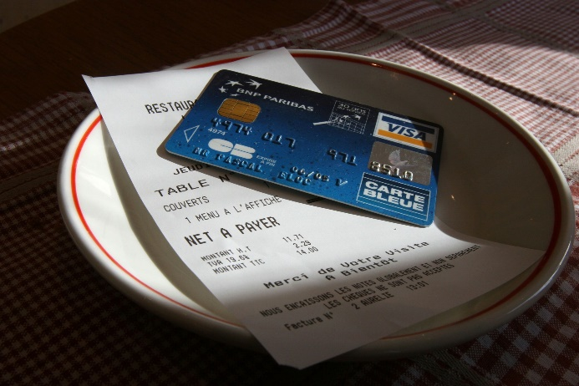
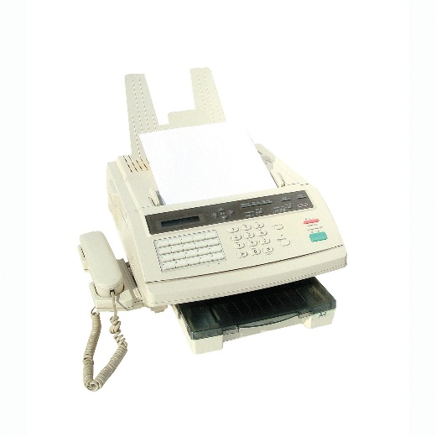
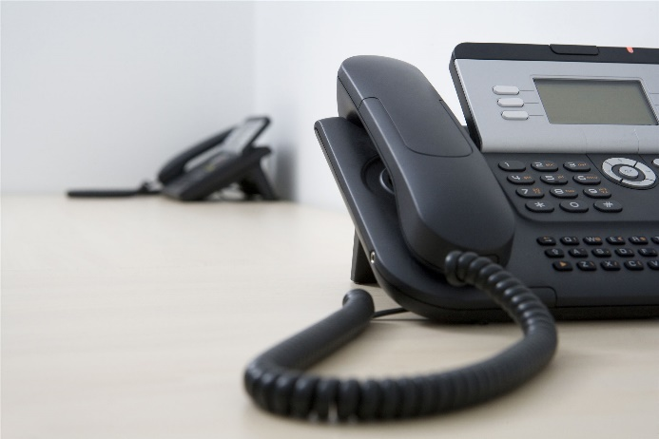
Exercise 2: Write down the English expressions for each picture.
credit card
信用卡
cash
现金
Fax
传真
tel.
电话

Slide 181
Exercise 3: Complete the following sentences.
1. What kind of room would you like to_________ (预订)?
2. How would you like to _________(付费)?
3._________ (多久) do you plan/intend to stay?
4. We have_________ _(可预订的房间) in that period.
5. I’m afraid our hotel is _________(满的) booked on that night.
book
pay
How long
rooms available
fully

Slide 182
2. Read an invitation Cards.
Wonderful Hotel
REGISTRATION FORM
Surname: Smith First Name: Will Sex: Male
Nationality: USA Telephone: 136903958××
Arrival Date: Oct. 2nd Arrival Time: 9 am Departure Date: Oct, 10th Departure Time: 7 am
Permanent Address: No. 206 JACKSON STREET, NEW YORK
Room No.: 1208 Room Rate: $120/night
My account will be settled by: Cash ✓ Credit Card Check Company account | Please Note: I will bear all my expenses in the hotel. Safe deposit boxes are available in the guestroom. The hotel will not be liable for any items left unattended. Check-out time is 12:00 noon.

Slide 183
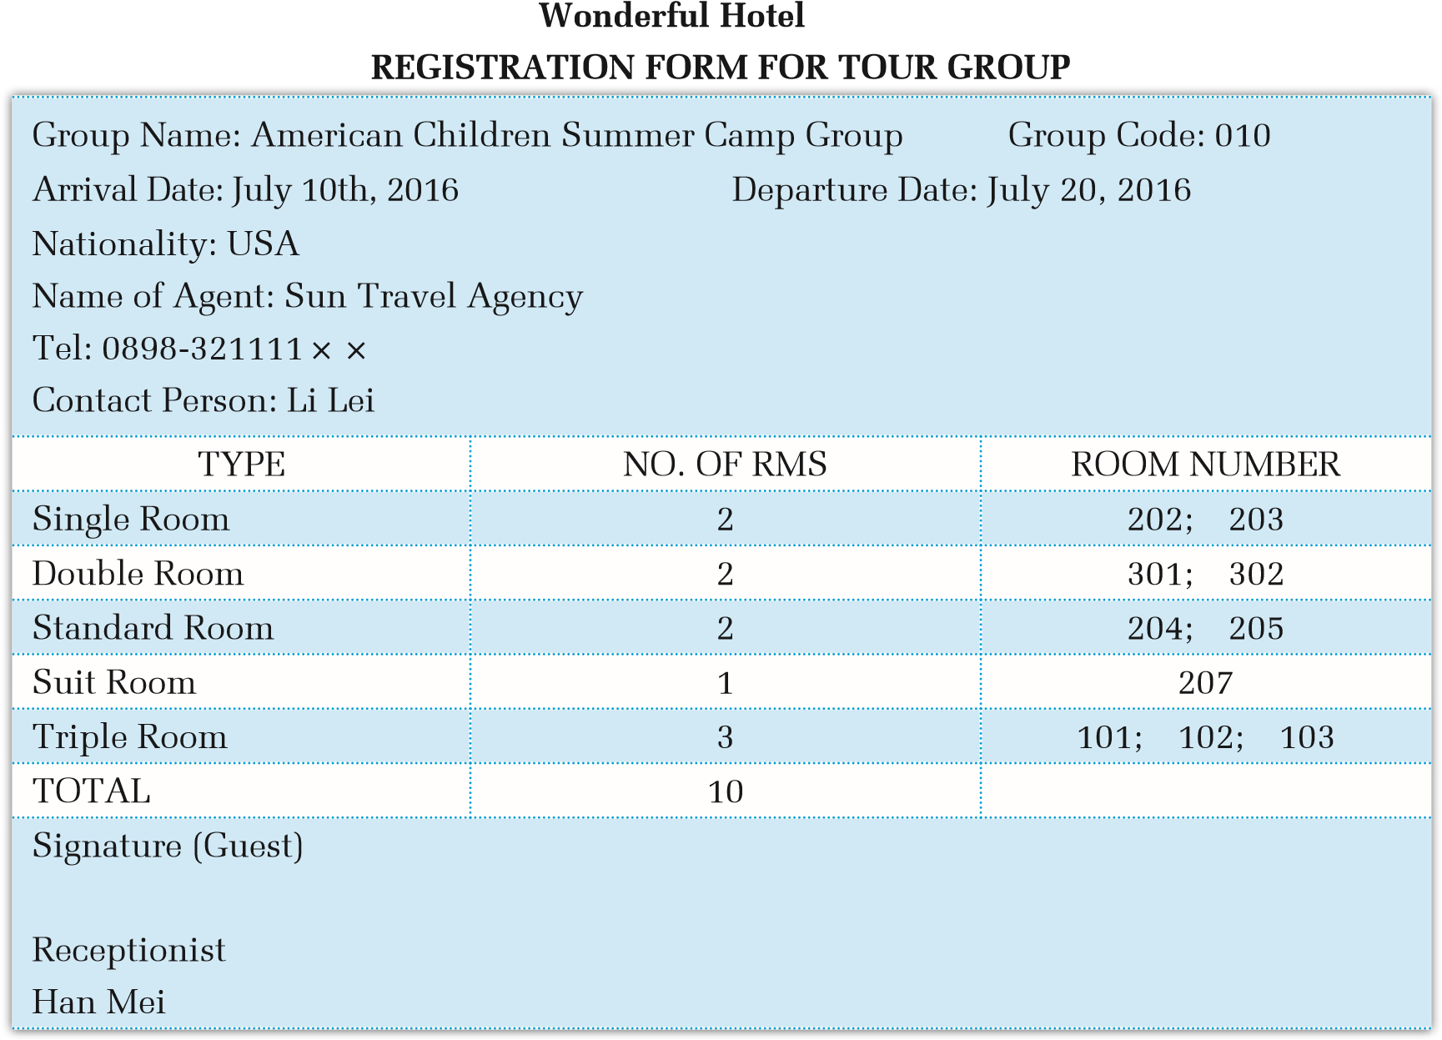

Slide 184
Exercise 4: Fill out the reservation form according to the information below. Add some more information if necessary.
加拿大人Anna Gates来中国旅游，想预订中国Flower Hotel的房间。她到达的时间是2016年9月1日上午9:30。计划于9月10日下午2:00离开。她需要一间标准间。房间价格是每晚588元。用信用卡支付房费。她的电子信箱是Anna@hotmail.com.

Slide 185
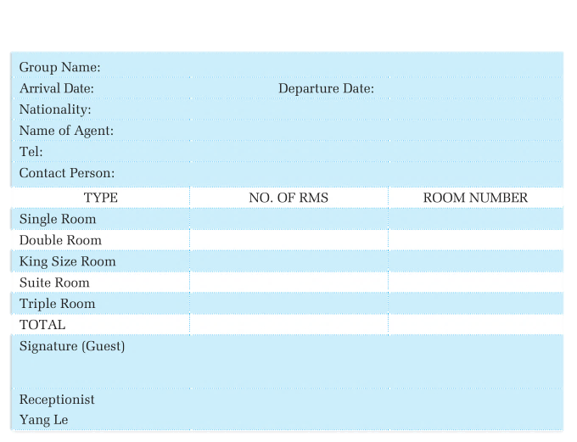
Exercise 5: Fill out the reservation form according to the information below. Add some more information if necessary.
杭州旅行社的导游赵敏，将于2016年10月15日带一个16人的澳大利亚旅游团来北京，预计游玩5天。听说北京花园酒店环境很好，服务周到，打算为旅行团预订这里的房间。按客人需求预订套间1间，单人间3间，大床房2间，双人间4间。付款方式是信用卡。
Beijing Graden Hotel
REGISTRATION FORM FOR TOUR GROUP

Slide 186
Back To Contents
To The Next Section

Slide 187
Section V Career Salon: Chinese Dining Etiquette
Chinese Dining Etiquette
If you are in China and you are asked by your Chinese friends to go out to dinner, you may want to know how to pick your seat at the table and what is the proper way to sit at the table. The seat which is facing the door of the room is normally the seat for the host or the hostess. One may also distinguish the seats at the table from the style in which the napkins are folded. Regardless of how the napkins are arranged, the tallest arrangement will always correspond to the master
seat.
There is usually a smaller table on the big table which is called a “lazy Susan”. This can make things easier for us. Because in the Chinese way of having food, we don’t order our own food. We order for everybody and everybody shares the food on the table. And usually we can have each of the people at the table to order one of the dishes. So what if something I want is on the other side of the table, I can turn the lazy Susan and turn it to my side. I can just pick it up without standing up and reaching out which is not proper or polite in Chinese table manners. And of course when someone else is getting some food you are not going to turn the lazy Susan at that time.

Slide 188
Most Chinese people have the tradition of making toasts at banquets. The order of the toast may be based on age from the eldest to the youngest, by social position from high to low, or by guest status from principal to secondary. One may propose a toast at any time throughout the meal, and making several toasts to one person is acceptable as well. If the guests’ glasses are less than half full, the host will help refill glasses for them. When people make a toast to a superior person, they usually make sure that the rim of their glass clinks at a position lower than the rim of the other person’s glass, which expresses respect and modesty.
To show good hospitality, the host usually urges the guest to eat more. For children, relatives or close friends, they will even serve the dishes themselves. The guests are supposed to accept the serving and kindly show their appreciation. Even if they do not like the particular dish, they do not refuse the serving but simply accept it and leave it at the side of their plate.
When eating in restaurants in China, tips are not necessary.

Slide 189
Back To Contents
To The Next Unit

Slide 190
Unit 8 Hotel Marketing
1
Section I Introduction: Hotel Salesperson
Section II Intensive Reading: How to Work in Sales at a Hotel
2
3
Section III Extensive Reading: Hilton Shanghai
4
Section IV Writing: Hotel Ads
5
Section V Career Salon: Dining Etiquette in Western Countries
Back

Slide 191
Section I Introduction: Hotel Salesperson
A hotel salesperson talks with clients in person and on the phone to increase sales and profit (利润). A hotel salesperson, also called a sales associate (销售助理), increases a hotel’s profitability and number of occupied rooms and public spaces by appealing to clients. A hotel salesperson works closely with advertising, marketing (市场营销) and public relations departments to draw in new and existing (现有的) clients. Working directly under the sales manager, the salesperson also maintains (维护) the customer database and prepares schedules for the sales manager and other sales associates.
A qualified hotel salesperson shall
➢ Work well with the sales team;
➢ Get professional (专业的) training in sales and marketing;
➢ Be knowledgeable about the hotel;
➢ Be confident (自信的) and friendly.

Slide 192
Back To Contents
To The Next Section

Slide 193
Section II Intensive Reading: How to Work in Sales at a Hotel
Before Reading
Exercise 1: What is the product that a hotel sells?

Slide 194
Exercise 2: What skills are needed for a sales person working in a hotel?

Slide 195
Passage
How to Work in Sales at a Hotel
The sales department of a hotel is responsible for selling services and events that are held at the hotel. The sales people work directly with guests in the planning of their events. For this reason, the salesperson must know everything about the hotel and has to be professional when talking with clients. Here is some advise about how to work in sales at a hotel.
Try to take marketing classes in college so that you will learn how to make connections with potential clients and sell the hotel to those people. It’s unnecessary to major in marketing but a few classes will look impressive on a resumé.
Be knowledgeable about the hotel. You should know details such as how many rooms there are in the hotel, which rooms are suites and what special deals (if any) guests can receive. Most hotels will actually make you take a test on this information before you can work in the sales department.

Slide 196
Work your way up from the bottom of the hotel “ladder.” Many people who go on to work in sales at a hotel actually start at the front desk. At the front desk, you will learn the check-in software and other computer programs used by the hotel. This is also a chance to show your skills working with people.
Be able to sell yourself. You should be confident yet personable when talking with others on the phone, in person and via email. Remember that you are, in fact, selling a product. As a number of the sales department of the hotel, you are the face of that product.
Learn by watching. Watch how others in the department deal with clients and any sticky situations. After you see this in action, you will know how you should act towards clients.

Slide 197
After Reading
Exercise 3: Match the following two groups of words and phrases.
1. 机会
2. 解决
3. 自信的
4. 销售部
5. 活动
6. 潜在客户
7. 细节
8. 专业的
9. 负责任的
10. 底部
a. sales department
b. responsible
c. event
d. professional
e. potential client
f. detail
g. bottom
h. chance
i. deal with
j. confident

Slide 198
Exercise 4: Fill in the blanks to complete each sentence according to the passage.
1. You will learn how to make connections with __________clients and sell the hotel to those people.
2. Most hotels will actually make you__________ on this information before you can work in the sales department.
3. At the front desk, you will learn the check-in __________and other computer programs.
4. As the sales department of the hotel, you are the __________of that product.
5. Watch how others in the department__________ clients and any sticky situations.
potential
take a test
software
face
deal with

Slide 199
Back To Contents
To The Next Section

Slide 200
Section III Extensive Reading: Hilton Shanghai
Passage
Hilton Shanghai
Hilton Shanghai, the city’s first international hotel, has been recognized as a top business hotel in Shanghai for its convenient location and outstanding facilities for more than 20 years.
However, the hotel’s newly appointed general manager Gerd Knaust says it is the people that make the hotel successful.
More than 380 employees have been working with the hotel for more than 15 years. Some of them have personal relationships with customers.
“It’s a people-relation business,” Knaust says. “They really tell me about the stories in the last 15 years. It’s something very nice to listen to. It’s also a lasting memory for the guests.”

Slide 201
In fact, over the years, some of the guests have stayed in the hotel 200 or even 300 times.
Knaust, who has been working in the hospitality industry for more than 30 years, started his career as a chef in Germany. During his early 30s, Knaust already moved to the top in the culinary (烹调的) field as director of kitchen of Hyatt Regency Cologne in Germany.
After holding several general manager positions in Mandarin Oriental hotels, Knaust joined Hilton International as the general manager to open the Conrad and Doubletree by Hilton at Haitang Bay, Sanya in 2010.
When he was appointed as the general manager of Hilton Shanghai in November, he not only was heavily involved in recruitment, sales and marketing strategies but also he worked closely with the food and beverage team to develop the hotel’s restaurant concepts and menus.
“I believe that we should offer quality and healthy food.” he says.
Knaust believes that a hotel must value the customers’ comments on Ctrip, Trip Advisor and other platforms.
“It keeps us more on guard to be 100 percent professional,” he says.

Slide 202
After Reading
Exercise 1: Decide whether the following statements are true (T) or false (F) according to the passage.
1. Hilton Shanghai is the first international hotel in China. ( )
2. Gerd Knaust is the hotel’s newly appointed general manager. ( )
3. All the employees of Hilton Shanghai have personal relationships with customers. ( )
4. Knaust has been working in the hospitality industry for more than 10 years. ( )
5. Knaust started his career as a clerk in Germany. ( )
6. The Conrad and Doubletree by Hilton at Haitang Bay, Sanya were opened in 2010. ( )
7. Knaust was only heavily involved in recruitment, sales and marketing strategies. ( )
8. Knaust worked closely with the food and beverage team to develop the hotel’s restaurant concepts and menus. ( )
9. Knaust believes that they should offer quality and healthy food. ( )
10. Knaust believes that a hotel must value the customers’ comments on the Internet. ( )
F
T
F
F
F
T
F
T
T
T

Slide 203
Exercise 2: Fill in the blanks with words or phrases according to the passage.
Knaust’s Working Experience | position
Started career in Germany as
Worked in Hyatt Regency Cologne in Germany as
Worked in Mandarin Oriental hotels as
Joined Hilton International as
Works in Hilton Shanghai as
a chef
director of kitchen
general manager
general manager
general manager

Slide 204
Back To Contents
To The Next Section

Slide 205
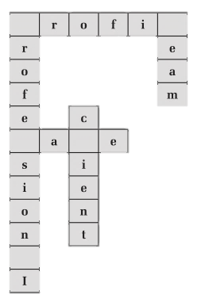
Section IV Writing: Hotel Ads
1. Finish the following exercises concerning the useful words and expressions in this unit.
Exercise 1: Fill in the blanks to complete each word.
p
t
s
l
a

Slide 206
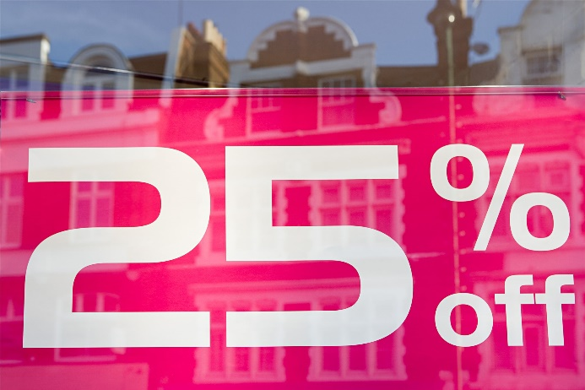

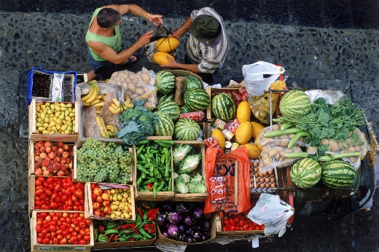

Exercise 2: Write down the English expressions for each picture.
折扣
discount
在线预订
online booking
售卖产品
sell a product
客户评价
customers' comment

Slide 207
Exercise 3: Complete the following sentences.
1. I’m afraid that no _________(折扣) can be provided.
2. This is the _________(宣传册) of our hotel.
3. We provide free _________(早餐).
4. Please accept our hotel’s little _________(纪念品) .
5. Our hotel values the customers’_________ (评价) very much.
discount
brochure
breakfast
souvenir
comments

Slide 208
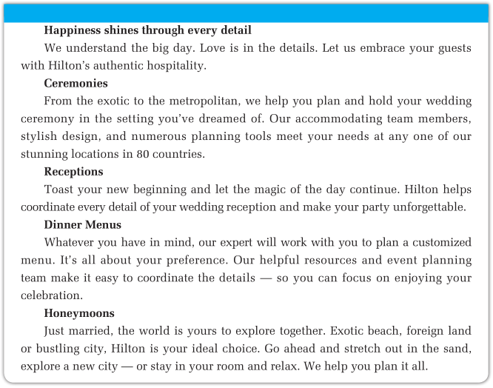
2. Read a sample of Hotel Ads.

Slide 209
Exercise 4: Write a hotel advertisement according to the following information.
庆祝新年酒店住宿优惠
从2016年12月15日至2017年2月10日
免费上网
享受15％的折扣每间/夜（最少2晚住宿）
免费使用酒店的游泳池和健身房
穿梭巴士（shuttle bus service）前往唐人街
现在预订就可以度过一个难忘的新年（包括中国2017年新年）假期

Slide 210
Exercise 5: Write an advertisement for the Great Wall Sheraton Hotel Beijing according to the following information.
北京喜来登长城饭店，一家五星级酒店，位于朝阳区东三环北路（East 3rd Ring North Road）。拥有便利的交通和优良的地理位置，距离北京首都国际机场20分钟车程。北京喜来登长城饭店有1027间客房，拥有北京最大的酒店花园，客人可在此享受美好的夏季夜晚。北京喜来登长城饭店为客人提供最好的居住环境和优质的服务。

Slide 211
Back To Contents
To The Next Section

Slide 212
Section V Career Salon: Dining Etiquette in Western Coutries
Dining Etiquette in Western Countries
People who go to a formal Western dinner party for the first time may be surprised by table manners in Western culture. Having good table manners means knowing, for example, how to use knives and forks, when to propose a toast and how to behave at the table. Beside your napkin you will find a small bread roll and three glasses — one for white wine, one for red wine, and one for water. There are two pairs of knives and forks on the table, forks on the left and knives on the right of the plate. When you see two spoons, the big one is for the soup and the small one for the dessert. The knife and fork that are closest to your plate are a little bit bigger than the ones beside them. When you sit down at the table, you can take your napkin, unfold it and put it on your lap. In China, you sometimes get a hot, damp cloth to clean your face and hands, which, however, is not the custom in western countries. Dinner starts with a small dish, which is often called a starter. Some people pray before they start eating, and other people may keep silent for a moment. Then you can say “Enjoy your meal” to each other and everybody starts eating.

Slide 213
For the starter, which you eat with the smaller pair, you keep the knife in your right hand and the fork in your left. After the starter you will get a bowl of soup — but only one bowl of soup and never ask for a second serving. The next dish is the main course. Many westerners think the chicken breast with its tender white flesh is the best part of the bird. Some people can use their fingers when they are eating chicken or other birds, but never touch beef or other meat on bones. It is polite to finish eating everything on your plate, so don’t take more food than you need.
At the table, you should try to speak quietly and smile a lot, but do not laugh all the time. Most Westerners like soft drinks if they will drive home. Many of them drink white or red wine with the food. When drinking to someone’s health, you raise your glasses, but the glasses should not touch. The custom of toasting in some parts of China is to finish the drink at once, but Westerners usually take only a sip. For drinking during a dinner, the best advice is never to drink too much.
Table manners change over time. They follow the fashion of the day. Besides, table manners are only important at formal dinner parties. If you are not sure what to do, you can always follow your hosts. Although having good manners always makes you look good, you do not need to worry about all these rules while having dinner with your friends or family.

Slide 214
Back To Contents
To The End

Slide 215
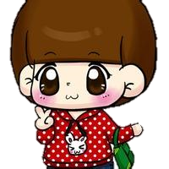
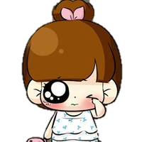
图文编辑
老青
刘素琴

Slide 216


校对
PPT制作
End
剧思远
续亚琪

